Slide 1

St Michaels and All Angels Curriculum Evening 2024
ST MICHAEL & ALL ANGELS C. E. (FOUNDATION) PRIMARY
AND PRE-SCHOOL
Welcome to Year 2
Miss Stewart

Slide 2






School Values
Behaviour Principles Written Statement
Our emphasis is on people within the school community taking responsibility for their actions, encouraging good choice-making through establishing high expectations, a focus on learning, as well as acknowledging and understanding actions have consequences whilst recognising and celebrating positive choices. Our policies are deeply rooted in a Restorative Approach.

Slide 3
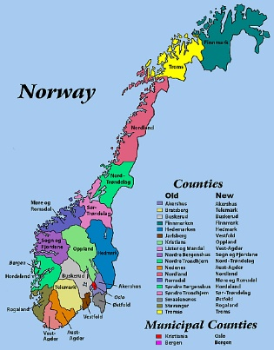

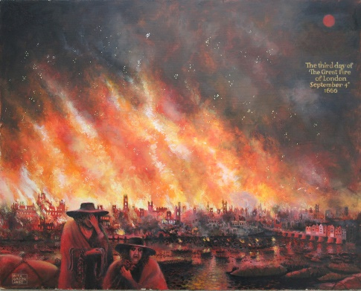
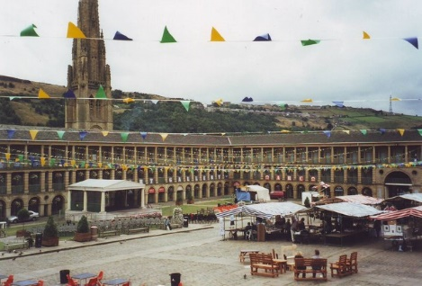

What do we learn in Year 2

Slide 4
What are the expectation in year 2 and what do we learn?

Slide 5
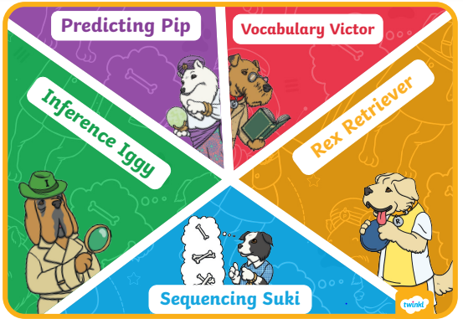
Reading:
Comprehension skills

Slide 6
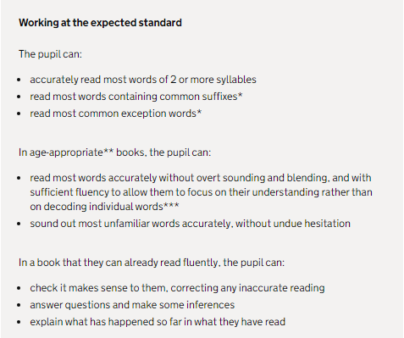
Reading:
Year 2 Expectations

Slide 7






Writing:
Book Based Writing Units

Slide 8
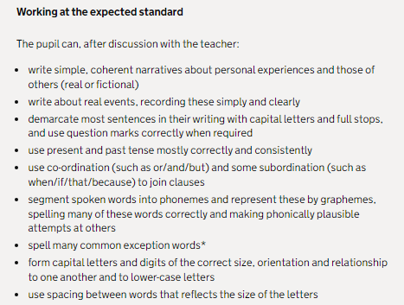
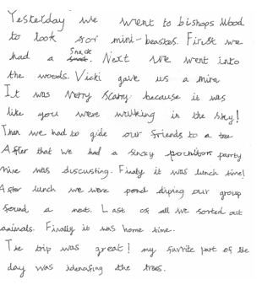
Writing:
Meeting Year 2 Expectations

Slide 9
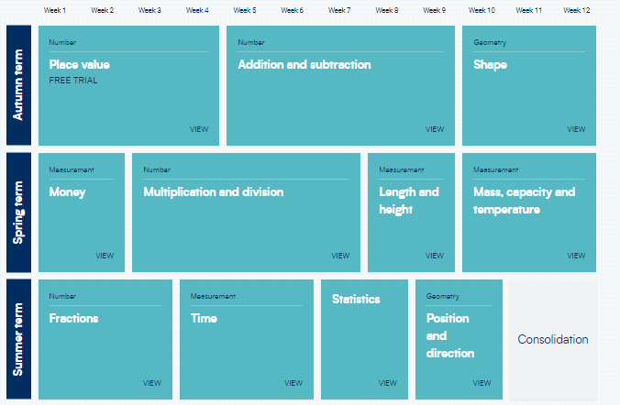
Maths
Topics taught in year 2

Slide 10
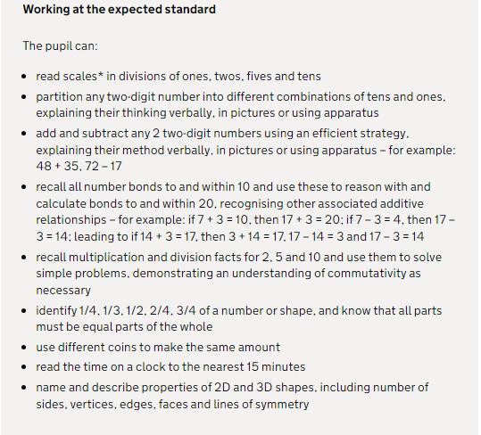

Slide 11
Assessment
Children will complete SAT papers 3 times a year focusing on Maths, Reading and SPaG. English assessments will also take place 2 times a term. Levels for these assessments will be communicated through parents evenings, mid term and end of year reports.
Levels:
Below Expectations
Working towards
Working at age related
Greater depth
It is common for levels to drop in Year 2 due to the transition from Year 1 to Year 2.

Slide 12
Learning at home
TT Rock Stars is a game that enables children to practice their speed and recall of times tables facts –your child will be assigned a times table to practise and this will be monitored. This should also be completed every week. Times Tables Rock Stars (ttrockstars.com)
Reading at home. Reading at home is extremely important in ensuring children’s progress in reading comprehension. We suggest reading at least three times a week
Your child’s login is in their reading record. Paper copies can be handed out for both if needed.

Slide 13
Extras and questions
Reading at home– Your child will be sent home with a reading book matched to their level.
Everybody will continue on Little Wandle for the next couple of week. Fluency test will be completed to determine whether they are ready to be moved onto the reading scheme.
There are educational games/ activites on our school website https://www.st-michaelangels.calderdale.sch.uk/special/kidszone/
P.E will take place on Monday and Wednesday. At the moment children should have their outdoor PE kit which is a t-shirt, navy bottoms, a jumper and trainers.
Snack is provided daily – this is fresh fruit. Children can buy Toast on Tuesday & Friday also.

Slide 14



Slide 15
Communication
If you have any questions you can call the school office or ask at the door to arrange a time to speak.

