Slide 1

St Michaels and All Angels Curriculum Evening
ST MICHAEL & ALL ANGELS C. E. (FOUNDATION) PRIMARY
AND PRE-SCHOOL
Welcome to Year 1

Slide 2






School Vision
Our Vision
Curious minds, resilient learners, compassionate community.
Be strong and courageous (Joshua 1:9)
Notes:
Assembly
House Points

Slide 3
School Values

Slide 4
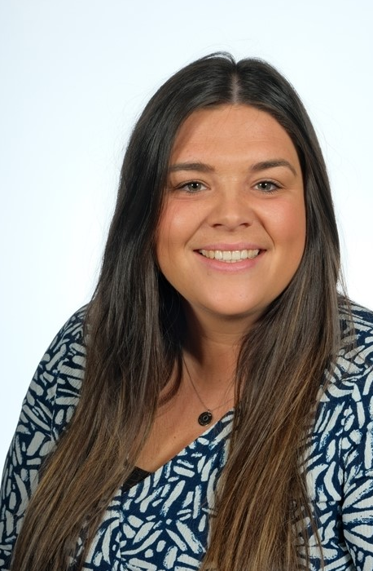
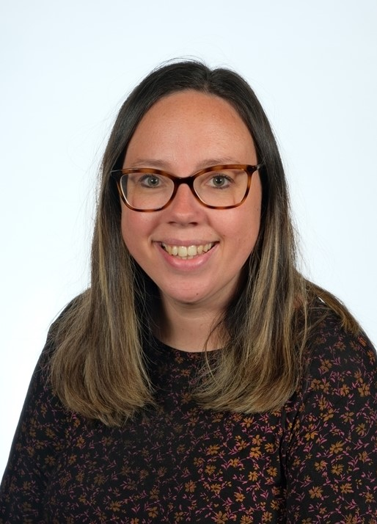
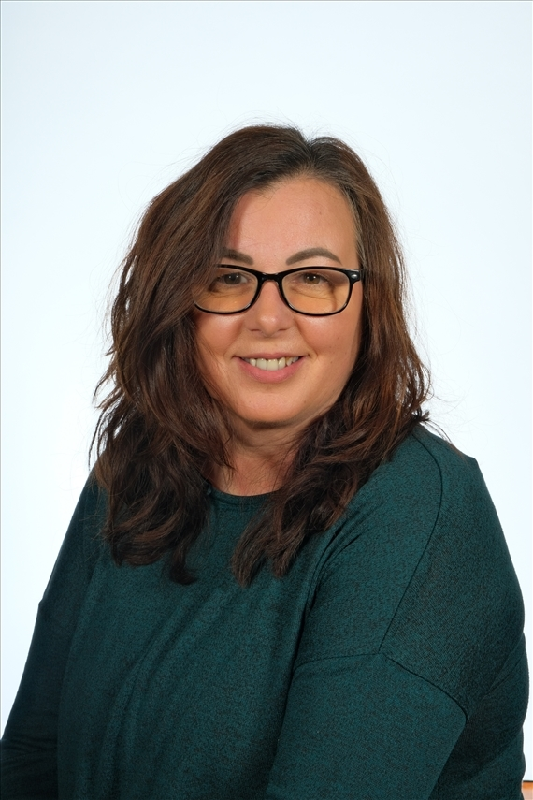
Staff in Year 1

Slide 5
What do we learn in Year 1?
Main Topics:
Autumn 1- Autumn & How have I changed?
Autumn 2 - Animals/Climates
Spring 1 - Where do we live? The Human Body
Spring 2 - Toys
Summer 1 – Kings, Queens & Castles
Summer 2 – Growing things, Weather

Slide 6
Meeting Year 1 Expectations
Phonics:
Say all letters of the alphabet and the sounds which they represent
40+ sounds
The process of segmenting spoken words into sounds
Division of words in syllables
Notes:
23rd October

Slide 7
Year 1 Expectations: Reading
WORD READING
Apply phonic knowledge and skills as the route to decode words
Match all 40+ graphemes to their phonemes (Phase 3)
Blend sounds in unfamiliar words based on known GPCs
Read common words using phonic knowledge where possible
Read words containing taught GPCs and s, es, ing, ed, er , est endings
Read words of more than one syllable that contain taught GPCs
Read words with contractions, e.g. I’m, I’ll, we’ll, and understand that the apostrophe represents the omitted letter(s)
Read phonically decodable texts
Read phonically decodable texts with confidence

Slide 8
Year 1 Expectations: Spoken Language
Speak clearly and loudly enough to communicate meaningfully.
Ask questions about matters of immediate interest.
Express feelings and ideas when talking about matters of immediate interest.
Start to develop ideas by adding detail to their speech.
Start to understand how to take turns when speaking.
Start to listen to others and respond appropriately.
Join in with imaginative play taking on roles of different familiar characters.
Speak in complete sentences after modelling and as appropriate.
Retell a familiar story in sentences, using narrative language.
Recount an event or experience in sentences.
Begin to understand how to change language when speaking to different listeners. For example – peers and adults.

Slide 9
Reading: Meeting Year 1 Expectations
COMPREHENSION
Develop pleasure in reading, motivation to read, vocabulary and understanding
Respond to a range of texts – narrative, non-fiction and poems.
Say what they like or dislike about a text.
Link what they read or hear read to their own experiences.
Know some key stories , including traditional and fairy tales.
Retell key stories orally using narrative language.
Understand and talk about the main characteristics of the key stories known.
Experience poems and rhymes.
Learn some poems and rhymes by heart.
COMPREHENSION
Understand both the books they can already read accurately and fluently and those they listen to
Use prior knowledge to understand texts.
Use context and vocabulary provided to understand texts.
Check that the text makes sense to them as they read and correct miscues.
Talk about the title and the events.
Begin to draw inferences from the text and/or the illustrations.
Make predictions based on the events in the text.
Talk about their responses in a group.
Listen to others’ ideas about a text.
Explain what they understand about a text.

Slide 10
Writing:
Meeting Year 1 Expectations
COMPOSITION
Write sentences.
Say out loud what is to be written about.
Talk about ideas to use in writing.
Compose a sentence orally before writing it.
Sequence sentences to form short narratives.
Sequence sentences in chronological order to recount an event or an experience.
Re-read what they have written to check that it makes sense.
Discuss what they have written with the teacher or other pupils.
Read aloud writing clearly enough to be heard by their peers and the teacher.
VOCABULARY, PUNCTUATION AND GRAMMAR
Leave spaces between words.
To understand the concept of a sentence.
Join words and sentences using and.
Begin to punctuate sentences using a capital letter and a full stop, question mark or exclamation mark.
Use a capital letter for names of people, places, the days of the week, and the personal pronoun ‘I’.
Use the terminology:
Word, sentence, letter, capital letter, full stop, punctuation, singular, plural, question mark, exclamation mark.

Slide 11
Spelling:
Meeting Year 1 Expectations
Apply simple spelling rules
Identify known sounds in unfamiliar words.
Use syllables to divide words.
Use knowledge of alternative sounds to narrow down possibilities for accurate spelling.
Write from memory simple sentences dictated by the teacher that include words taught so far.
Add prefixes and suffixes
Use the spelling rule for adding s or es for plural
Use the prefix un
Add ing, ed, er, est where no change is needed to the root words

Slide 12
Maths:
Meeting Year 1 Expectations
Number:
Counting forward and backwards to 100
Addition and Subtraction
Multiplication and Division
Fractions (Half and quarters)
Measurement:
Money (values of coins)
Time (hour and half past)
Days/ Months of the year
Length and height
Weight and Volume
Geometry:
Shapes 2D and 3D

Slide 13
Maths:
‘Must do’ by the end of Year 1
Measurement
Recognise half and quarter of object, shape or quantity.
Sequence events in order.
Use language of day, week, month and year.
Name the days of the week and months of the year.
Recognise all coins
Tell time to hour and half past.
Count to and across 100, forwards and backwards from any number.
Read and write numbers to 20 in digits and words.
Read and write numbers to 100 in digits.
Say ‘1 more’ and ‘1 less’ to 100.
Count in multiples of 1, 2, 5 and 10.
Know bonds to 10 by heart.
Use bonds and subtraction facts to 20.
Add and subtract:
  1 digit and 2 digit numbers to 20, including zero.
  Add any three 1-digit numbers with a total up to 20.
  Solve simple addition and division with apparatus and arrays.

Slide 14
Personal, Social and Emotional Development
We learn about respectful relationships and how to express our feelings and consider the feelings of others.
Correct terminology is used to name correct body parts
We will also talk about consent and what this means e.g asking before holding someone's hand

Slide 15
Assessment
Autumn Term- Teacher Assessments using target card to track where you child is. This is referred to throughout the year to support children to recognise their own individual targets
Spring Term- Mixture of Teacher Assessments (English) and NFER tests (Reading and Maths)
Summer Term- Mixture of Teacher Assessment (English) and NFER tests (Reading and Maths). As well as the Phonics Screening Test in June.

Slide 16
Year 1 Phonics Screening Test
Every Year in June the Year 1 children sit the phonics screening test. The test consists of 40 words which are both real and false. The first 20 words include sounds from phases 2 and 3. The next 20 consist of sounds from phase 4 and 5. The children need to be able to read these words independently. In the test we must be able to hear each individual sound correctly. This is really important in order to check understanding and recognition of each sound.
Practice papers can be found through the following website: https://www.gov.uk/education/phonics

Slide 17
Learning at Home
Our home learning has been thoughtfully designed to ensure that it is effective and fun.
The focus is on practising key skills (reading, spelling and maths skills).
Teachers closely link homework to children’s current learning to ensure it is accessible and relevant to all.

Slide 18
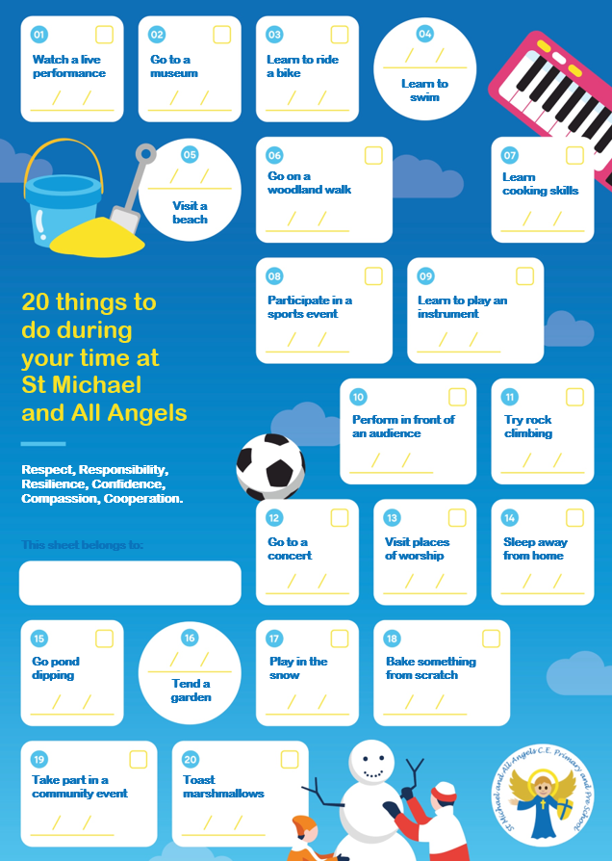
20 things to do before leaving
During the year your child will experience 6 enrichment activities e.g trip, local walk, visitors,

Slide 19
Communication
Home school communication policy
We will contact you through emails and messages via MCAS (My Child At School)
All communication should go through the school office preferably by email for all none-urgent issues.
We aim to acknowledge emails within 2 days and a full response as per the home school communication policy.

Slide 20

READING AT HOME
Your child will be sent home with a reading book matched to their reading/phonic level. This is their ‘learning to read’ book. It should be familiar to them as it will have been read in Group Reading.
They also have the option to take a library book home weekly. This is their, ‘reading for pleasure’ book to be enjoyed by themselves or with a family member.
It is important that they are listened to read regularly and we ask you do this at least 3 x per week. Reading records should be signed to log this.
*It is important these books are looked after as we
are unable to replace lost or damaged books*

Slide 21
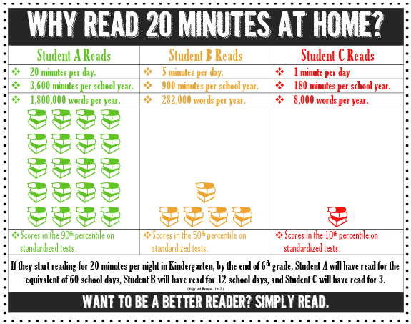


Slide 22
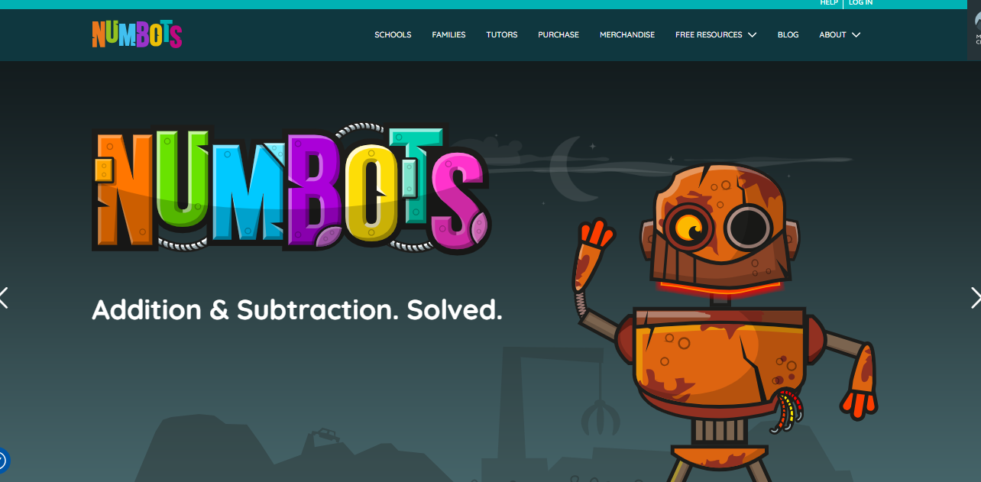
Numbots

Slide 23
How to help
-Work which can be done at home
Regular and frequent reading at home. Communication in reading records is appreciated
In your child’s reading record logins for Numbots can be found. These website can be accessed anytime online and will be tracked.
Letter and number formation. Writing on a line and letters being correct size and orientation.
100 High Frequency Words and tricky words both provided in their reading record.
Maths Magicians practise can be found in reading records- starting the rainbow award (number bonds to 10)
Counting to 100 forward and backwards. Or in 2’s, 5’s and 10’s

Slide 24
Final points and questions
Reading books – Changed every week according to phonics level. Children visit the library once a week (Wednesday)
Playtime – Please make sure your child brings a coat to school (labelled with your child’s name).
Snack – we provide fresh fruit every day. There is also the option of toast on a Tuesday & Friday.
School website
PE Days – Monday and Friday, your child can attend school in their outdoor P.E kit and remain in this for the rest of the day.
Thank you.

