Slide 1

St Michaels and All Angels Curriculum Evening 2026/27
ST MICHAEL & ALL ANGELS C. E. (FOUNDATION) PRIMARY
AND PRE-SCHOOL
Welcome to Year 3
Mrs Tordoff

Slide 2
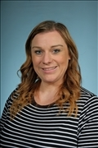
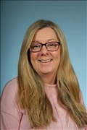
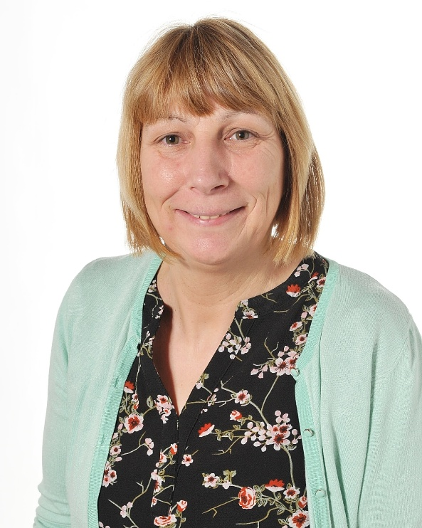
Our Staff
These are the staff working in Year 3 this year.
Mrs Tordoff
Mrs Bedford
Mrs Nalton

Slide 3






School Values
Our Vision
Curious minds, resilient learners, compassionate community. Be strong and courageous (Joshua 1:9)

Slide 4
PSHCE
Across school we will use language to support children in respecting relationships with others and how to consider others, express their own views and feelings. This will also link to consent, online safety and what this means e.g. using passwords, asking before holding hands.
We also use the correct terminology for body parts throughout school. This is one of the ways of keeping ourselves healthy.

Slide 5
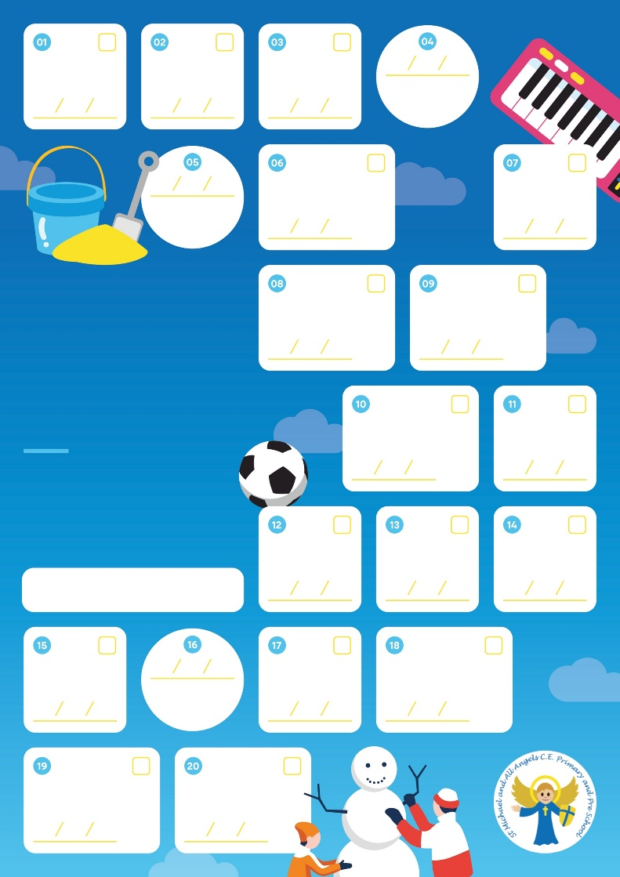
20 things to do during your time at St Michaels
Over the year there will be 6 enrichments that your child will take part in.
Keep a look out on Facebook to see the photos

Slide 6
What do we learn in Year 3?
In Year 3 there is a brilliant and engaging curriculum covering a range a topics. Here are just a few things we will be learning about.
Autumn 1: Stone Age
Autumn 2: Ancient Greece
Spring 1: Forces and Magnets
Spring 2: Plants
Summer 1: Natural disasters
Summer 2: Light

Slide 7
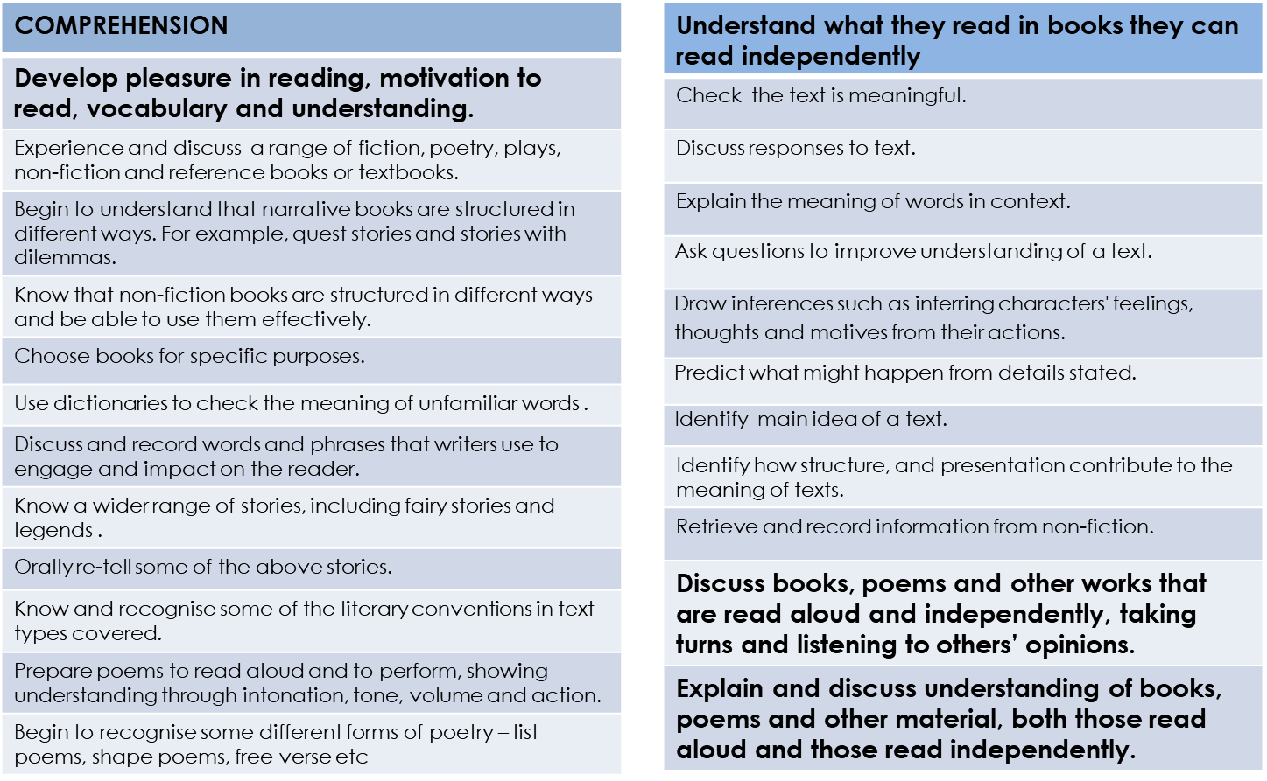
Reading: Year 3
Expectations

Slide 8
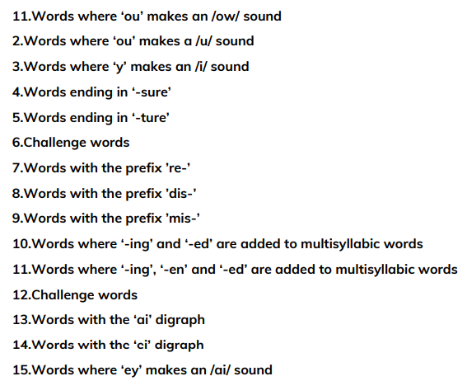
Reading: Year 3 Expectations
Spelling: Year 3 Expectations
WORD READING
Apply phonic knowledge and skills to read unfamiliar words.
Apply knowledge of root words, prefixes and suffixes to read aloud and to understand the meaning of unfamiliar words.
Read further exception words, noting the unusual correspondences between spelling and sound, and where these occur in the word.
Attempt pronunciation of unfamiliar words drawing on prior knowledge of similar looking words

Slide 9
Writing: Year 3 Expectations
Year 3 Expectations: Transcription
Spell words with additional prefixes and suffixes and understand how to add them to root words, for example – form nouns using super, anti, auto
Recognise and spell additional homophones, for example – he’ll, heel, heal
Use the first two or three letters of a word to check its spelling in a dictionary
Spell correctly word families based on common words, for example – solve, solution, solver
Spell identified commonly misspelt words from Year 3 and 4 word list
Make analogies from a word already known to apply to an unfamiliar word
Identify the root in longer words
Use the diagonal and horizontal strokes that are needed to join letters
Understand which letters, when adjacent to one another, are best left unjoined
Increase the legibility, consistency and quality of handwriting
Year 3 Expectations: Composition
Look at and discuss models of writing of the text type, purpose and audience to be written, noting: structure; grammatical features and use of vocabulary
Compose sentences using a wider range of structures linked to the grammar objectives
Write a narrative with a clear structure, setting, characters and plot
Write a non-narrative using simple organisational devices such as headings and sub-headings
Suggest improvement to writing through assessing writing with peers and self assess
Make improvements by proposing changes to grammar and vocabulary to improve consistency, e.g. the accurate use of pronouns in sentences
Use a range of sentences with more than one clause by using a wider range of conjunctions, e.g. when, if, because, although
Use the perfect form of verbs to mark relationships of time and cause
Use conjunctions, adverbs and prepositions to express time and cause
Proof-read to check for errors in spelling and punctuation errors

Slide 10
Maths: Year 3 Expectations
Write down all numbers said to them up to 1000
Know place value of each digit in a 3-digit number
Order a set of 3-digit numbers: greatest first, smallest first
Count on and back from any number in 2s, 3s, 4s, 5s, 8s, 10s, 50s, and 100s up to 1000
Know 100 more than a given number to 1000
Know 100 less than a given number to 1000
Add 2 or 3 numbers with 3-digits, using column addition
Subtract 2 numbers with 3-digits using column subtraction
Rapid recall: Add rapidly a 3-digit number to a 1-digit number; to a 10s number; and to a 100s number
Subtract rapidly a 1-digit number from a 3-digit number; a 10s number and a 100s number
Rapid Recall: 2x, 3x, 4x, 5x, 8x, 10s tables and their inverses
Multiply a 2-digit number by a 1-digit number
Divide 2, 3, 4, 5, 8 and 10 into a 2-digit number (no remainder)
Fractions: Find ½,¼, of a 2-digit number
Order fractions from ½ to 1/12
Know pairs of fractions that make up 1 whole
Know equivalent fractions of ½,¼, and 1/10
Add 2 fractions with same denominator
Subtract 1 fraction from another with same denominator

Slide 11
Assessment
Children will complete NFER Tests 3 times a year focusing on Maths, Reading and SPaG.
English assessments will take place 2 times a term. Levels for these assessments will be communicated through parents evenings, mid term and end of year reports.
Maths assessments are completed at the end of each unit and will be used in class to support learning.
Levels:
Below Expectations
Working towards age related
Working at age related
Greater depth
The jump to KS2 is a big one!

Slide 12
Learning at home
TT Rock Stars is a game that enables children to practice their speed and recall of times tables facts –your child will be assigned a times table to practise and this will be monitored. This should also be completed every week. Times Tables Rock Stars (ttrockstars.com)
Your child will be set a new assignment on the Spelling Shed website each week according to their weekly spellings. The more practice the better! Children gain rewards on the game the longer they play and this will be monitored this. Stickers will be awarded weekly for accessing this. http://play.edshed.com/
Your child’s login for both is in their reading record. Paper copies can be handed out for both if needed.

Slide 13


Reading
Reading at home– Your child will be sent home with a reading book matched to their level. If your child is still on our phonics scheme, this will be different (same as year 1/2). It is important that they are listened to regularly and we ask you to do this at least 3 x per week. Reading records should be signed to log this and we aim to change shorter books after three reads or once completed if a longer/ chapter book.
We will be going to the school library once a week on a Thursday so please remember to bring books back each week to swap them.
We ask for a £5 donation on MCAS if any books are lost or damaged.

Slide 14
Communication
School will contact you through the MCAS App (My Child At School) – Please ensure your push notifications are on so you can be notified with these.
Emails to the school office is a preferred way to contact school for non urgent enquiries. We aim to acknowledge you within 2 days and this will be followed up as per the home/school policy.
Phone calls will still be made when required such as first aid.
Please refer to the home/school policy on the website for further information.

Slide 15
Extra Information
P.E will take place on Monday and Wednesday.
At the moment children should have their outdoor PE kit which is a t-shirt, navy bottoms, a jumper and trainers.
Snack is not provided in Year 3 so please ensure children have a small piece of fruit or healthy snack for break times.

