Slide 1

St Michaels and All Angels Curriculum Evening 2025
ST MICHAEL & ALL ANGELS C. E. (FOUNDATION) PRIMARY
AND PRE-SCHOOL
Welcome to Year 5
Miss Stewart

Slide 2
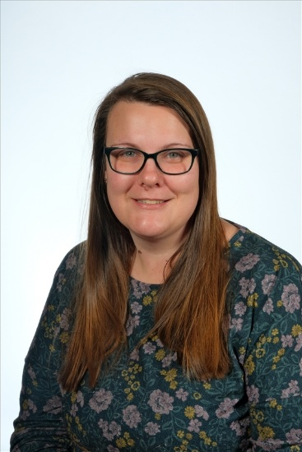
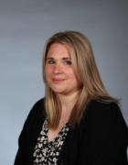
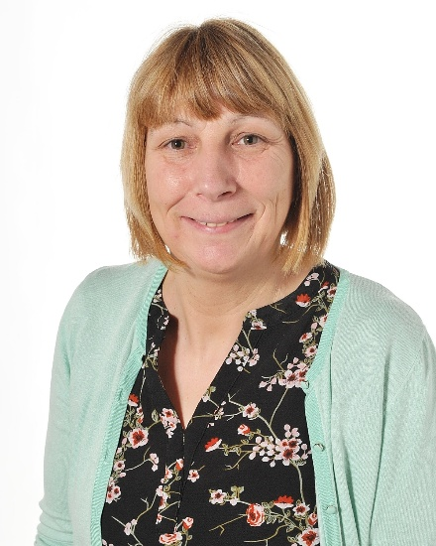
Our Staff
Miss Rivers
Teaching Assistant
Miss Stewart
Teacher
Mrs Nalton
Cover Supervisor

Slide 3






School Values
Our Vision
Curious minds, resilient learners, compassionate community.
Be strong and courageous (Joshua 1:9)

Slide 4
PSHCE
During the Summer Term we will be looking at ways of keeping ourselves healthy.
This will include looking at sensitive topics such as drugs and how these can affect the body.
We will also talk about consent and what this means.
Furthermore, there will be lessons on puberty and how the body changes as we get older.
We use the correct terminology for body parts throughout school.

Slide 5
What are the expectations in Year 5 and what do we learn?

Slide 6
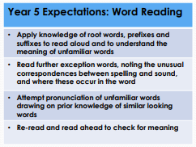
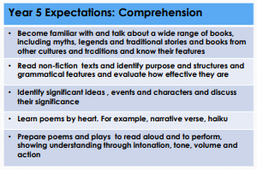
Reading:
Meeting Year 5 Expectations

Slide 7
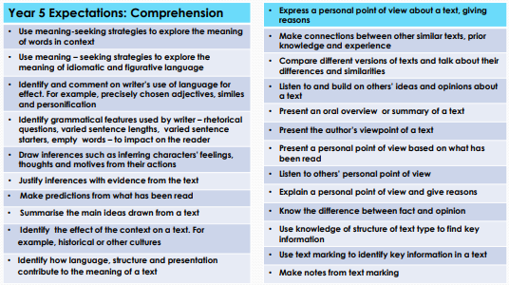
Reading:
Meeting Year 5 Expectations

Slide 8
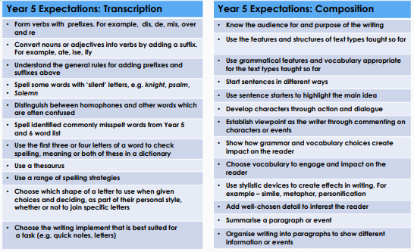
Writing:
Meeting Year 5 Expectations

Slide 9
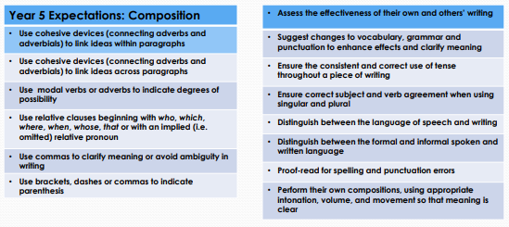
Writing:
Meeting Year 5 Expectations

Slide 10
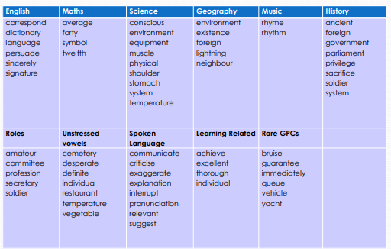
Spelling:
Year 5/6 Word List: Words across the curriculum

Slide 11
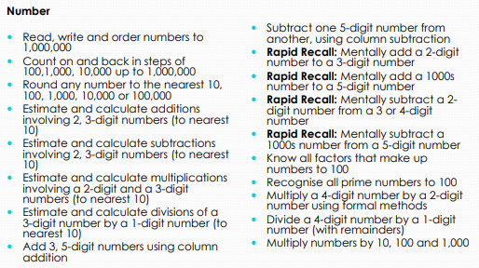
Maths:
‘Must Dos’ by the end of Year 5

Slide 12
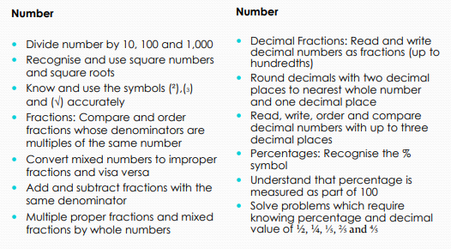
Maths:
‘Must Dos’ by the end of Year 5

Slide 13
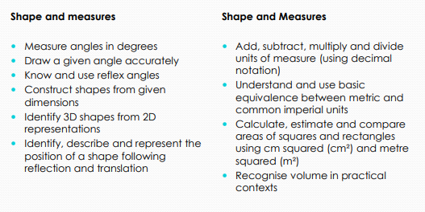
Maths:
‘Must Dos’ by the end of Year 5

Slide 14
Assessment
Progress monitored each term:
NFER assessments in reading, maths and SPAG
Writing assessments

Slide 15

Topics

Slide 16
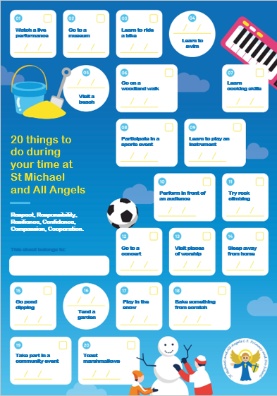
20 things to do at St Michael’s
During the year, your child will have an opportunity to take part of in 6 enrichment activities
These are
Local walk
Trip
Charity event
Enterprise event
Visitor
Parent Workshop

Slide 17
Communication
All communication should go through the school office.
Preferably, by e-mail to the school admin in the first instance for non- urgent issues.
We aim to acknowledge the email within 2 days and a full response within 5 days.
We contact you through emails and messages on MCAS.
For further clarification read the Home-School Communication Policy on the website.

Slide 18
Learning at Home
Our home learning has been thoughtfully designed to ensure that it is effective and fun.
The focus is on practising key skills (reading, spelling and times tables).
Teachers closely link homework to children’s current learning to ensure it is accessible and relevant to all.
Homework in Year 5
Online platforms Spelling Shed and TT Rockstars
Spelling homework book handed out on a Monday and handed back in the following Monday
CGP SPAG books will be sent home on a Wednesday and to be brought back every Monday (From Autumn 2)

Slide 19

Reading at home
Your child will be sent home with a reading book matched to their reading level. It is important that they are listened to read regularly and we ask you do this at least 3 x per week. Reading records should be signed to log this.
*It is important these books are looked after as we
are unable to replace lost or damaged books*

Slide 20
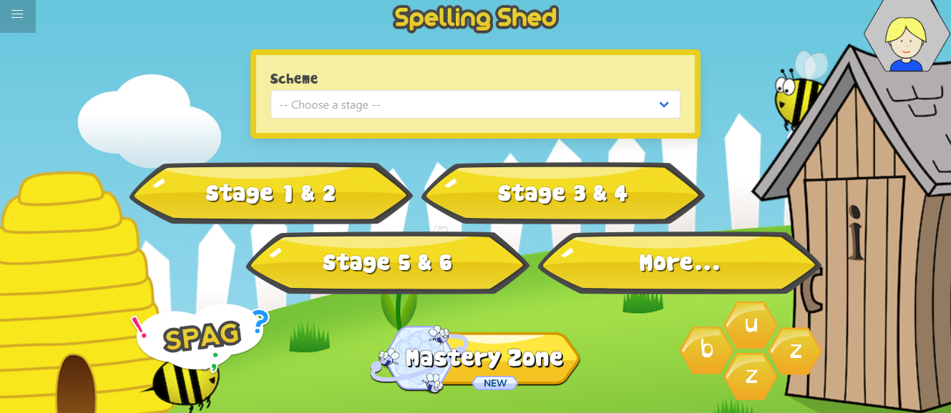
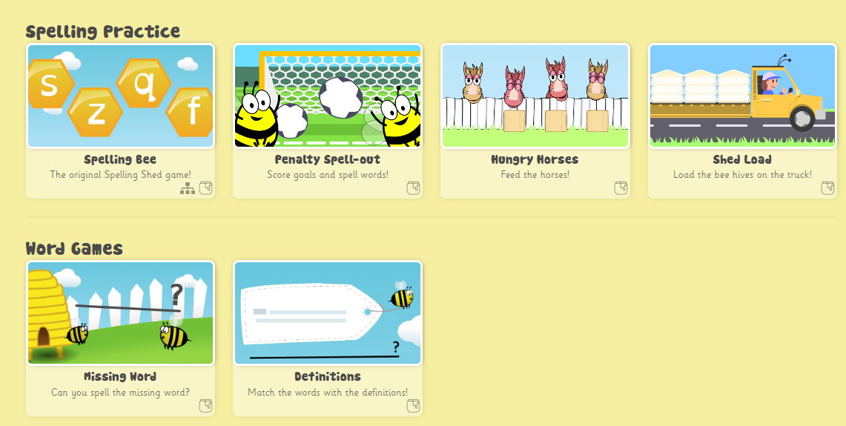
Spelling Shed
Notes:
Your child will be set a new assignment on the Spelling Shed website each week. Your child’s login is in their reading record. The website contains games to help your child consolidate their spellings for the week. The more practice the better! Children gain rewards on the game the longer they play and the teacher can monitor this. Stickers will be awarded weekly for accessing this.

Slide 21

Times Table Rockstars
Notes:
Times tables rock stars is a game that enables children to practice their speed and recall of times tables facts – the teacher will set your child a times table to practice and monitor their progress. This should also be completed every week. The longer spent on there, the more coins accumulated!

Slide 22

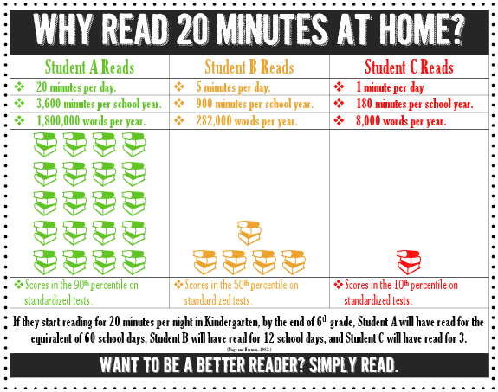

Slide 23
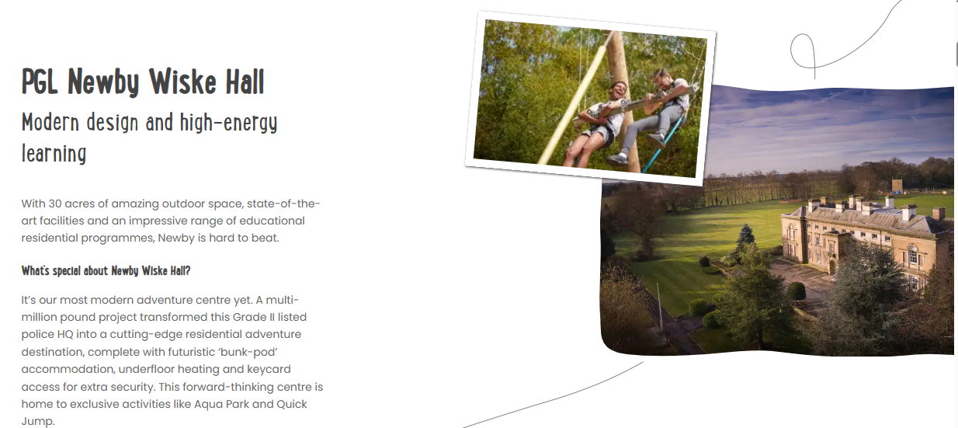
Kit list has been sent with everything your child needs
Medical forms need to be filled out and sent back into school by 30th September
If you would like to order boots or waterproof email admin

