Slide 1

St Michaels and All Angels Curriculum Evening
ST MICHAEL & ALL ANGELS C. E. (FOUNDATION) PRIMARY
AND PRE-SCHOOL
Welcome to Reception

Slide 2
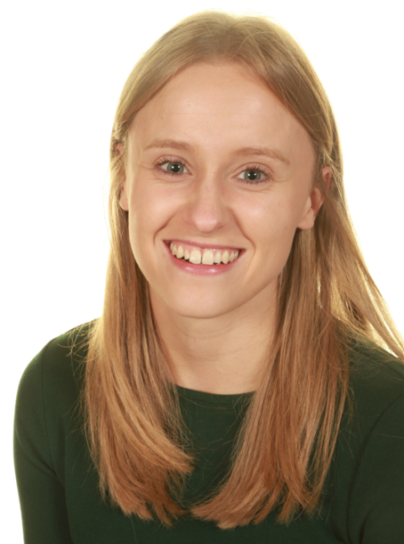
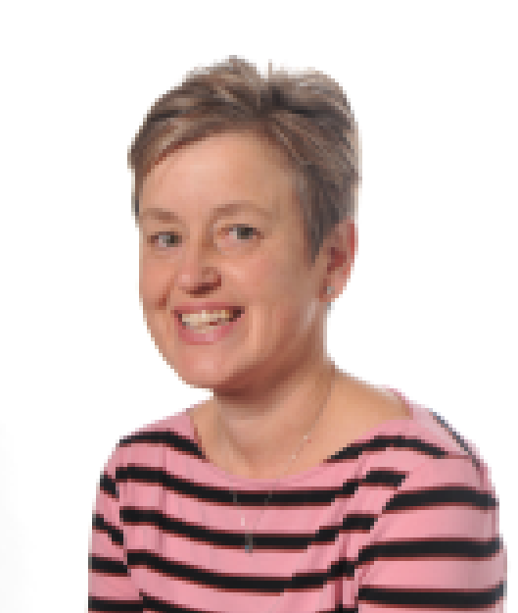
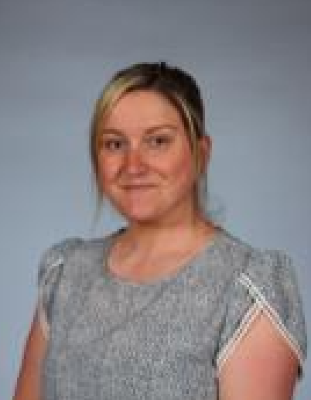
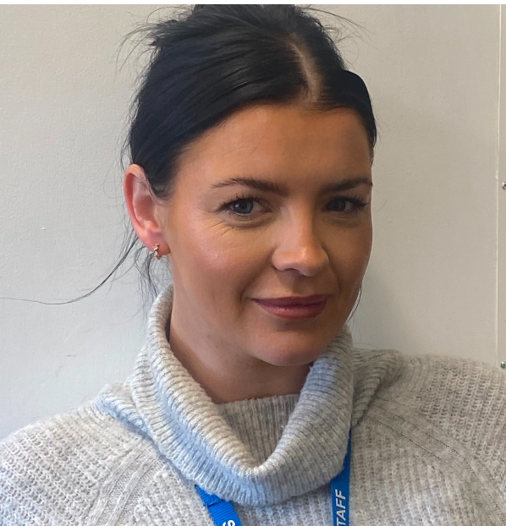
Our Staff
Miss Barnes Mrs Longstaff Mrs Gardener Mrs Griffiths

Slide 3






School Values
Curious minds, resilient learners, compassionate community.
Be strong and courageous (Joshua 1:9)

Slide 4
Personal, Social and Emotional Development
We learn about respectful relationships and how to express our feelings and consider the feelings of others.
Correct terminology is used to name correct body parts
We will also talk about consent and what this means e.g asking before holding someone's hand

Slide 5
Our Curriculum
Our curriculum is called the EYFS.
There are 7 areas of learning.
Prime areas:
Personal and Social Development
Physical Development
Communication and Language

Slide 6
Early Years
Specific areas:
Literacy
Maths
Understanding the World
Expressive Arts and Design
We are working towards achieving the Early Learning Goals (ELG) by next July.

Slide 7
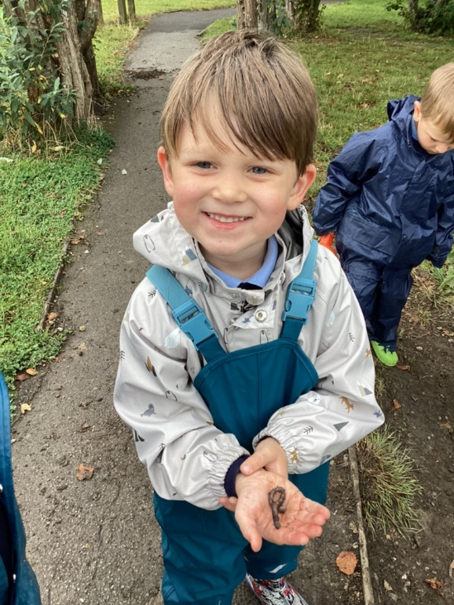
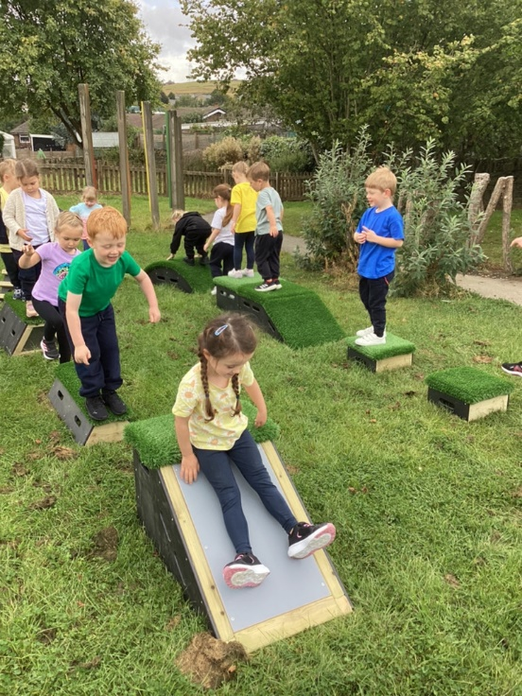
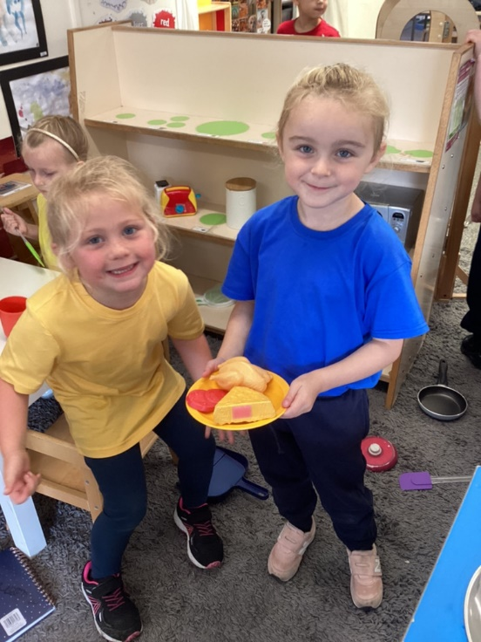
Learning through play

Slide 8
The School Day
Maths
Free play inside and outside / group activities
Phonics
Lunch
Carpet time
Free play inside and outside / group activities
Story

Slide 9







Number
Autumn 1 | Autumn 2 | Spring 1
Match and Sort Comparing size, mass, capacity Making simple patterns Representing and comparing 1, 2, 3 Composition of Numbers 1, 2, 3 | Circles and Triangles Spatial awareness Numbers 4 and 5 One more and one less Shapes with 4 sides Time | Introducing zero Comparing numbers to 5 Composition of 4 and 5 Comparing mass and capacity Numbers 6, 7, 8

Slide 10

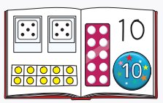
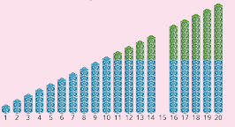
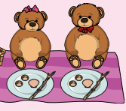


Number
Spring 2 | Summer 1 | Summer 2
Combining 2 groups Length, height Building 9 and 10 Comparing numbers to 10 Number bonds 3D shape and pattern | Building numbers beyond 10 Counting patterns beyond 10 Spatial reasoning Adding more Taking away | Doubling, sharing, grouping Even and odd Spatial reasoning Patterns and relationships

Slide 11
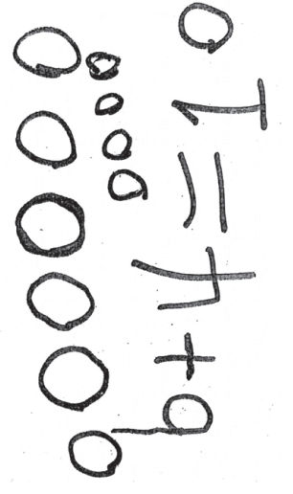

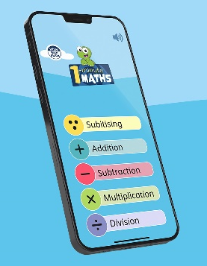

Number Early Learning Goal
Have a deep understanding of number to 10, including the composition of each number.
Subitise (recognise quantities without counting) up to 5.
Automatically recall (without reference to rhymes, counting or other aids) number bonds up to 5 (including subtraction facts) and some number bonds to 10, including double facts.

Slide 12

Writing
Autumn 1 | Autumn 2 | Spring 1
Mark making and give meaning to marks. Form taught letters Correct pencil grip | Forming taught letters | Writing some of the tricky words such as I, go, the, to Beginning to write sentences using finger spaces

Slide 13
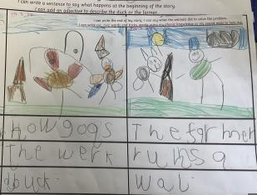
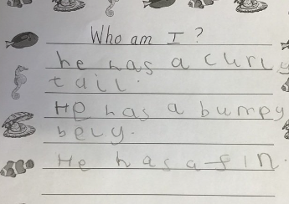
Writing
Spring 2 | Summer 1 | Summer 2
Writing simple sentences using finger spaces and beginning to use full stops. Spell tricky words and words using taught sounds. Write 2 or more sentences e.g story maps, character description | Beginning to use capital letters and full stops. Form lower case letters correctly. Write longer words which are spelt phonetically. Retell a story in their own words | Write sentences using a capital letters, finger spaces and a full stop. Form lower case and capital letters correctly. Reread what they have written to check it makes sense

Slide 14
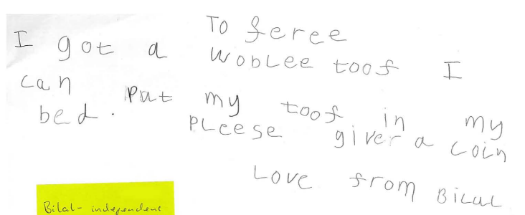
Writing Early Learning Goal
Write recognisable letters, most of which are correctly formed. Spell words by identifying sounds in them and representing the sounds with a letter or letters. Write simple phrases and sentences that can be read by others.

Slide 15

Tapestry
This is the system we use to record the children’s learning.
We collect photographs and observations of the children’s play and link them to the EYFS.
Children’s next steps will be added to Tapestry as well as wow moments.

Slide 16
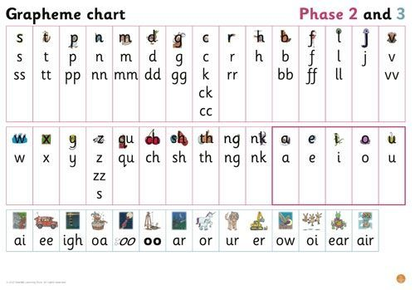
Phonics
Phonics is how we teach children to read and write. We will have a phonics lesson daily.

Slide 17
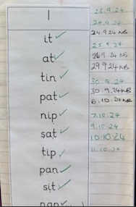
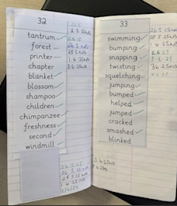
Reading
Children will bring home a reading book and a reading record.
Once children have a firm understanding of phonics, they will receive books they are able to read to you.
When children can recognise some sounds they will bring home a blending book. Reading this will help your child to improve their early reading skills.
Tricky words bags – to be kept in reading folder so new words can be added

Slide 18
Topic
Autumn 1 | Autumn 2 | Spring 1
All About Me Our School Autumn -Seasonal changes, | Diwali Transport Christmas Jolly Christmas Postman (maps) How we celebrate Christmas - Christmas in the past | People and Animals who help us Cold Places Dinosaurs Luna New Year

Slide 19
Topic
Spring 2 | Summer 1 | Summer 2
Planting and Growing Looking after our world | Past/ presents events in the lives of family members Farm animals Minibeasts | Sea creatures Pirates Space

Slide 20
PE
PE will be on a Friday morning
Children come dressed for PE
House T-shirts
Please make sure all ear-rings are out

Slide 21
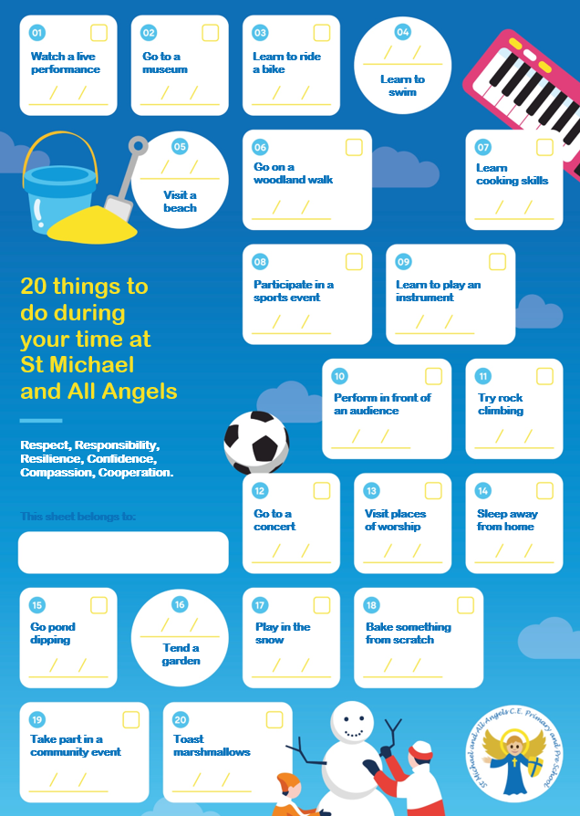
20 things to do before leaving
During the year your child will experience 6 enrichment activities e.g trip, local walk, visitors,

Slide 22
Celebration Worship
Celebration Worship is at 9 on a Friday
Grown-ups are invited to join us
A text will be sent out if your child is going to receive a certificate
Achievements from outside school can be shared
e.g swimming certificates

Slide 23
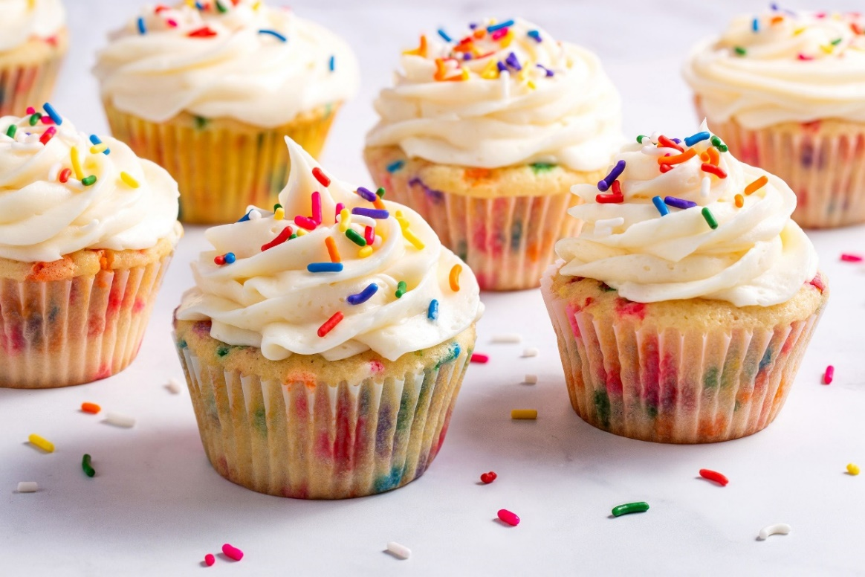
Afternoon tea
Each Friday a child from each class is picked to go to afternoon tea.

Slide 24
Other Things
Birthday invites
Christmas cards
Sweets
Story bear

Slide 25
Communication
Home school communication policy
We will contact you through emails and messages via MCAS (My Child At School)
All communication should go through the school office preferably by email for all none-urgent issues.
We aim to acknowledge emails within 2 days and a full response as per the home school communication policy.

Slide 26
Things you can do at home…
Read your child's reading book and blending book daily.
Practice pre-writing patters
Recognising numbers – games like snap or pairs.
Colouring books to strengthen pencil grip.
Encourage independence around the house e.g. making their bed, laying the table, dressing themselves, zipping coat or tidying up.
Create a rhyming string e.g hat, cat, mat
Play with play dough to strengthen finger muscles.
Read stories together
White Rose One Minute maths app
Play dominoes

