Slide 1

St Michaels and All Angels Curriculum Evening 2024
ST MICHAEL & ALL ANGELS C. E. (FOUNDATION) PRIMARY
AND PRE-SCHOOL
Welcome to Year 2

Slide 2
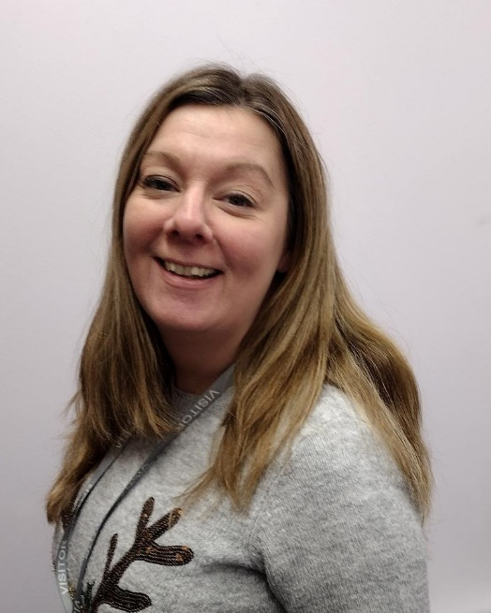
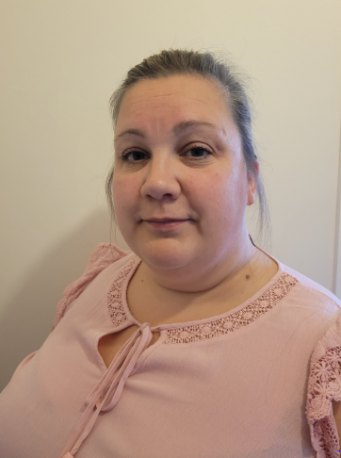
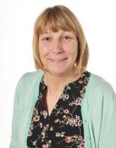
Our staff
These are the staff that are working in Year 2 this year.
Mrs Bedford
Miss Bowers
Mrs Nalton

Slide 3






School Values
Our Vision
Curious minds, resilient learners, compassionate community.
Be strong and courageous (Joshua 1:9)

Slide 4
During the Summer Term we will be looking at ways of keeping ourselves healthy.
We will also talk about consent, what this means and healthy relationships.
Furthermore, there will be lessons on puberty and how the body changes as we get older, using the correct scientific terminology.

Slide 5
What are the expectations in year 2 and what do we learn?

Slide 6
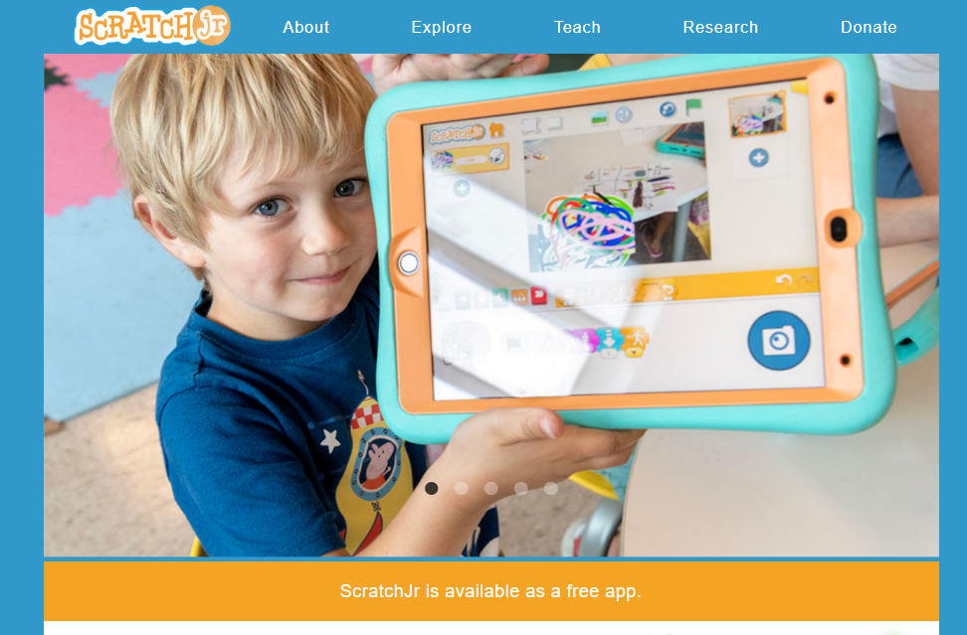

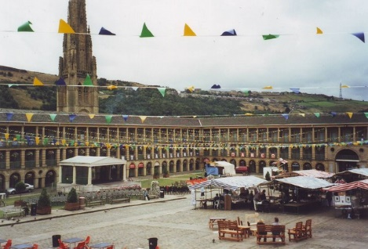

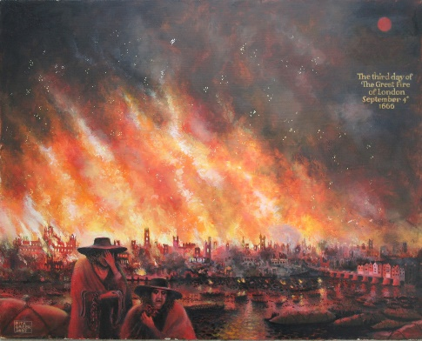
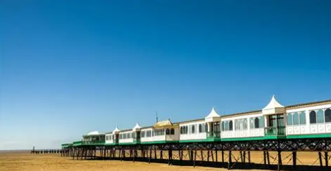
Our topics in Year 2…

Slide 7
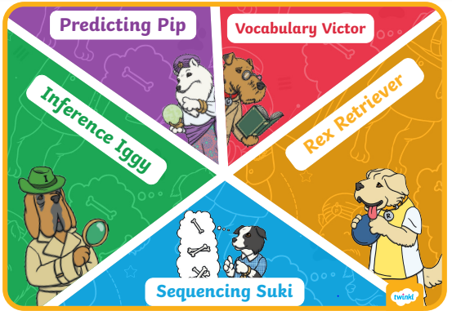
Reading:
Comprehension skills

Slide 8
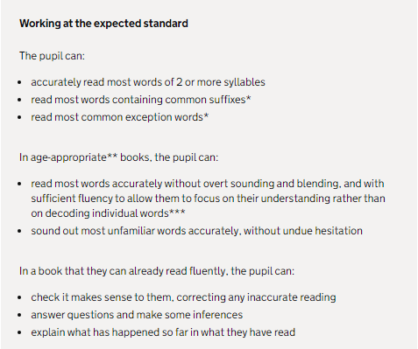
Reading:
Year 2 Expectations

Slide 9






Writing:
Book Based Writing Units

Slide 10
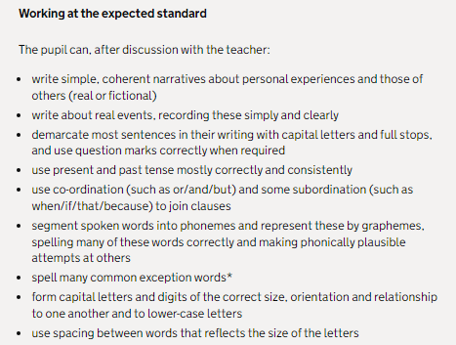
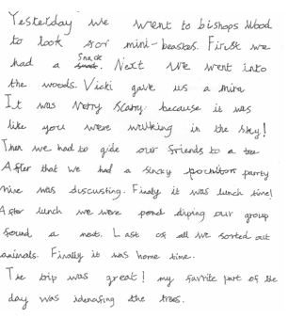
Writing:
Meeting Year 2 Expectations

Slide 11
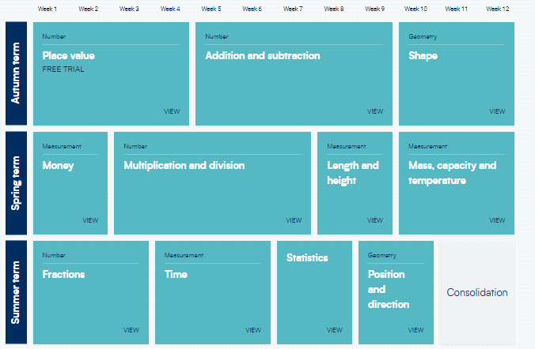
Maths
Topics taught in year 2

Slide 12
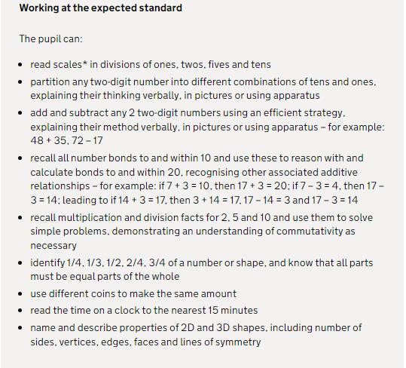

Slide 13
Assessment
Children will complete SAT papers 3 times a year focusing on Maths, Reading and SPaG. English assessments will also take place 2 times a term. Levels for these assessments will be communicated through parents evenings, mid term and end of year reports.
Levels:
Below Expectations
Working towards
Working at age related
Greater depth

Slide 14
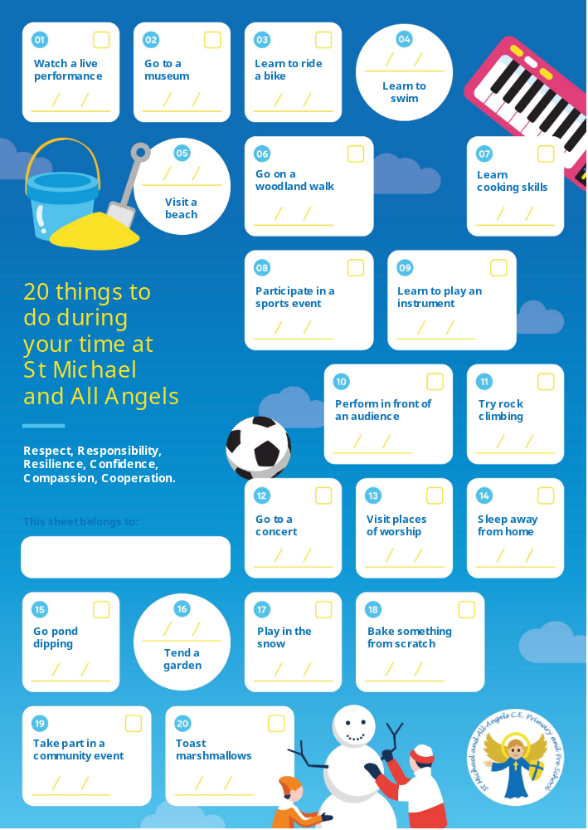
20 things to do at St Michaels before you leave
Over the year there will be 6 enrichments that your child will take part in.
Keep a look out on Facebook to see the photos

Slide 15
Learning at home
TT Rock Stars is a game that enables children to practice their speed and recall of times tables facts –your child will be assigned a times table to practise and this will be monitored. This should also be completed every week. Times Tables Rock Stars (ttrockstars.com)
Reading at home. Reading at home is extremely important in ensuring children’s progress in reading comprehension. We suggest reading at least three times a week
Your child’s login is in their reading record. Paper copies can be handed out for both if needed.

Slide 16
Extras and questions
Reading at home– Your child will be sent home with a reading book matched to their level.
Everybody will continue on Little Wandle for the next couple of week. Fluency test will be completed to determine whether they are ready to be moved onto the reading scheme.
There are educational games/ activites on our school website https://www.st-michaelangels.calderdale.sch.uk/special/kidszone/
P.E will take place on Monday and Wednesday. At the moment children should have their outdoor PE kit which is a t-shirt, navy bottoms, a jumper and trainers.
Snack is not provided in Year 3 so please ensure children have a small piece of fruit or healthy snack for break times.

Slide 17

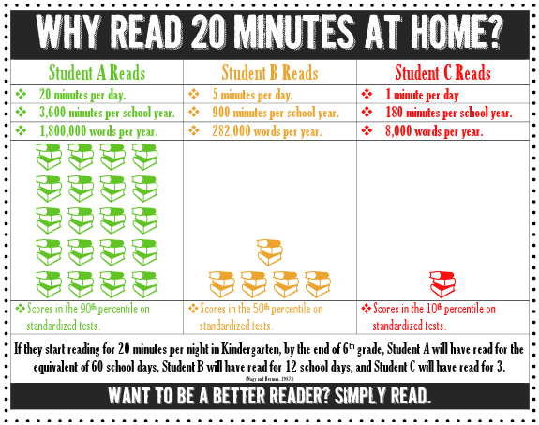

Slide 18
Communication
If you have more questions please feel free to stay behind.
Alternatively, you can call the school office to arrange a time to speak.
As per our communication policy, all communication must go through the school office. We aim to acknowledge within two days and a full response as soon as possible after that. Email is preferred.
Any further information can be found on the home-school communication policy can be found on the school website.
We contact you through emails and messages on MCAS(My Child at school).

