Slide 1

St Michaels and All Angels Curriculum Evening 2026
ST MICHAEL & ALL ANGELS C. E. (FOUNDATION) PRIMARY
AND PRE-SCHOOL
Welcome to Year 4
Mr. Barker

Slide 2
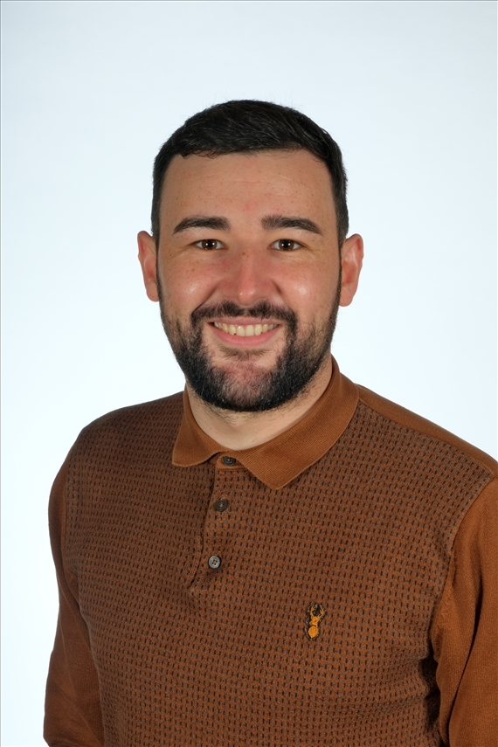
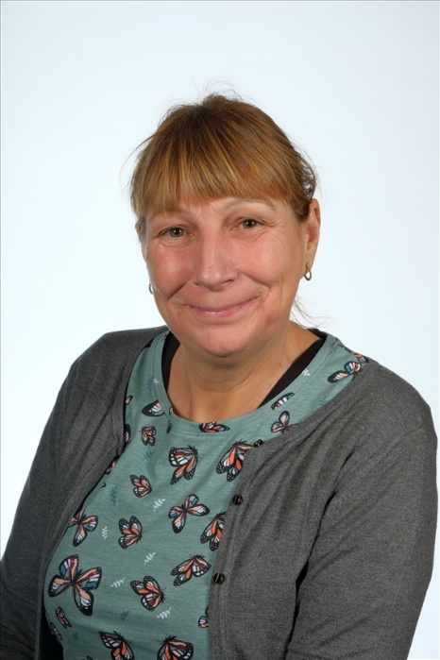
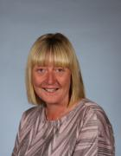
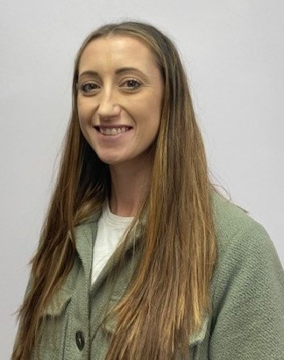
Our Staff
Mr. Barker
Class Teacher
Mrs. Nalton
Class Cover Supervisor (Tuesday AM)
Mrs. Bates
Class Teaching Assistant
Miss. Brickwood
Class Teaching Assistant

Slide 3






School Values
School Vision
Curious minds, resilient learners, compassionate community.
Be strong and courageous. (Joshua 1:9)

Slide 4
What are the expectations in Year 4 and what do we learn?

Slide 5
Reading:
Meeting Year 4 Expectations
Year 4 Expectations: Word Reading
Apply knowledge of root words, prefixes and suffixes to read aloud and to understand the meaning of unfamiliar words
Read further exception words, noting the unusual correspondences between spelling and sound, and where these occur in the word
Attempt pronunciation of unfamiliar words drawing on prior knowledge of similar looking words
Year 4 Expectations: Comprehension
Prepare poems to read aloud and to perform, showing understanding through intonation, tone, volume and action
Explain the meaning of words in context
Ask questions to improve understanding of a text
Infer meanings and begin to justify them with evidence from the text
Predict what might happen from details stated and deduced information
Identify how writer has used precise word choices for effect to impact on the reader
Identify some text type organisational features, for example, narrative, explanation, persuasion
Retrieve and record information from non-fiction
Make connections with prior knowledge and experience
Begin to build on others’ ideas and opinions about a text in discussion
Explain why text types are organised in a certain way
Year 4 Expectations: Comprehension
Know which books to select for specific purposes, especially in relation to science, history and geography learning
Use dictionaries to check the meaning of unfamiliar words
Discuss and record words and phrases that writers use to engage and impact on the reader
Know and recognise some of the literary conventions in text types covered
Begin to understand simple themes in books

Slide 6
Writing:
Meeting Year 4 Expectations
Year 4 Expectations: Transcription
Spell words with additional prefixes and suffixes and understand how to add them to root words. For example – ation, ous, ion, ian
Recognise and spell additional homophones, for example – accept and except, whose and who’s
Use the first two or three letters of a word to check its spelling in a dictionary
Spell identified commonly misspelt words from Year 3 and 4 word list
Use the diagonal and horizontal strokes that are needed to join letters
Understand which letters, when adjacent to one another, are best left unjoined
Increase the legibility, consistency and quality of their handwriting: down strokes of letters are parallel and equidistant; lines of writing are spaced sufficiently so that the ascenders and descenders of letters do not touch
Year 4 Expectations: Composition
Compose sentences using a wider range of structures, linked to the grammar objectives
Orally rehearse structured sentences or sequences of sentences
Begin to open paragraphs with topic sentences
Write a narrative with a clear structure, setting, characters and plot
Make improvements by proposing changes to grammar and vocabulary to improve consistency, e.g. the accurate use of pronouns in sentences
Use a range of sentences with more than one clause
Use appropriate nouns or pronouns within and across sentences to support cohesion and avoid repetition
Use fronted adverbials, for example, ‘Later that day, I went shopping.’
Use expanded noun phrases with modifying adjectives and prepositional phrases, eg, ‘The strict teacher with curly hair’
Use other punctuation in direct speech, including a comma after the reporting clause; use apostrophes to mark plural possession; and use commas after fronted adverbials

Slide 7
Spelling:
Meeting Year 4 Expectations
Requirements | Example Words
Words with endings sounding like /ʒə/ | measure, treasure, pleasure, enclosure
Words with endings sounding like /tʃə/ | creature, furniture, picture, nature, adventure
Prefixes: il -, im -, ir -, inter - , anti - | il - illegal, illegible im - immortal, impossible, impatient, imperfect ir - irregular, irrelevant, irresponsible inter– interact, intercity, international, interrelated anti – antiseptic, anti-clockwise, antisocial
Endings which sound like /ʒən/ | division, invasion, confusion, decision, collision, television
The suffix –ous | poisonous, dangerous, mountainous, famous, various, tremendous, enormous, jealous humorous, glamorous, vigorous, courageous, outrageous, serious, obvious, curious, hideous
Endings which sound like /ʃən/, spelt –tion, –sion, –ssion, –cian | invention, injection, action, hesitation, completion expression, discussion, confession, permission, admission expansion, extension, comprehension, tension musician, electrician, magician, politician, mathematician

Slide 8
Statutory Requirements | Example Words
Adding suffixes beginning with vowel letters to words of more than one syllable | forgetting, forgotten, beginning, beginner, prefer, preferred gardening, gardener, limiting, limited, limitation
Words with the /s/ sound spelt sc (Latin in origin | science, scene, discipline, fascinate, crescent
The suffix –ation | information, adoration, sensation, preparation, admiration
Revise and review homophones
Possessive apostrophe with plural words | girls’, boys’, babies’, children’s, men’s, mice’s

Slide 9
Maths:
‘Must Dos’ by the end of Year 4
Read and write all numbers to 10,000
Know place value of each digit in a 4-digit number
Order a set of 4-digit numbers: greatest first, smallest first
Count on and back from any number in 2s, 3s, 4s, 5s, 6s, 7s, 8s, 9s,10s, 25s, 50s, 100s and 1000s up to 10,000
Round a number to the nearest 10 or 100
Read and write negative numbers
Count on and back in negative numbers
Add a number of 4-digit numbers using formal methods
Subtract 2, 4-digit numbers using formal methods
Estimate the answer to additions with up to 3-digit numbers
Estimate the answer to subtractions with up to 3-digit numbers
Rapid Recall: All table facts up to 12x, including their inverses
Multiply 2-digit and 3-digit numbers by a 1-digit number
Divide 2-digit numbers by a 1-digit number
Recognise and use factor pairs within 144
Fractions: Identify and name equivalent fractions with the same denominator up to and including 12
Add and subtract fractions with the same denominator (within 1 whole)
Decimal Fractions: Order decimal fractions up to tenths and hundredths
Multiply and divide decimal fractions by 10 and 100
Recognise fractional value of decimal fractions

Slide 10
Topics in Y4
English | Billy Goat Gruff Red Riding Hood | Wallace and Gromit Varjak Paw | Arthur and the Golden Rope (Joe Todd Stanton For the Birds | The Time Slip Scarab The Iron Man | Romulus and Remus The Romans | The Water Cycle Rhythm of the Rain Lion of the Sky: Haiku for All Seasons
Science | States of Matter | Animals including humas | Sound | Electricity | Living Things and their habitats
Geography | Comparing Halifax to Sheffield | Australia |  |  | River and Water cycle
History |  |  | Ancient Egyptians |  | The Romans
Computing | The Internet | Audio Editing | Repetition in Shapes | Data Logging | Photo Editing | Repetition in Games
RE | How do ancient stories influence modern celebrations? | What is the trinity? | How do the 5 pillars of Islam help Muslims live a good life? | What do Christians call the day Jesus died- Good Friday? | Why do the lives of Gurus inspire Sikh believers? | What is it like follow God?
DT |  |  |  | Textiles | Cooking & Nutrition | Mechanical Systems
Art | Drawing | Painting | Sculpture
PSHCE | Relationships: -families and friendships -safe relationships. | Relationships: -respecting ourselves and others. | Living in the wider world: -belonging to a community. -media literacy and digital resilience. -money and work. |  | Health and wellbeing: -physical health and mental wellbeing. -Growing and changing. -Keeping safe.

Slide 11
Topics in Y4
PE | Development of Invasion Games Hockey & Tag Rugby (P) | Development of Gymnastics (M) | Development of Invasion Games Handball & Netball (C) | Development of Net & Wall Games Tennis (C) | Development of Striking and Fielding (P) | Development of Athletics (C)

Slide 12
PSHCE
During the Summer Term we will be looking at ways of keeping ourselves healthy.
We will also talk about consent and what this means.
Furthermore, there will be lessons on puberty and how the body changes as we get older.

Slide 13
Assessment
Progress monitored each term:
NFER assessments in Reading, Maths, SPAG
writing assessments.
Children complete a times table check in Year 4.
These will take place in June.
There will be an information evening for more information about this, and a reminder letter will follow nearer the time.

Slide 14
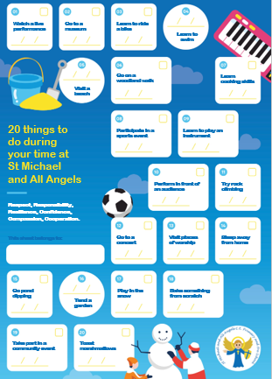
20 Things to do at St Michaels’
During the year, your child will take part in 6 enrichment opportunities.
A local visit
A parent workshop
A school trip
A charity event
An enterprise activity
A visitor

Slide 15
Learning at home
Our home learning has been thoughtfully designed to ensure that it is effective and fun.
The focus is on practising key skills (reading, spelling and times tables).
Teachers closely link homework to children’s current learning to ensure it is accessible and relevant to all.

Slide 16

Homework Expectations
Reading at home.
Your child will be sent home with a reading book matched to their reading level. It is important that they are listened to regularly and we ask that you do this at least 3x per week. Reading records should be signed to log this.
Spelling Books
Every week, you child will bring home weekly spellings to practise, these will be tested on a Monday morning.

Slide 17
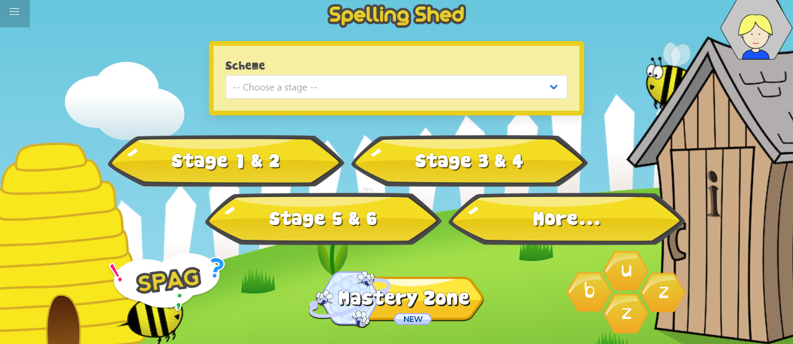
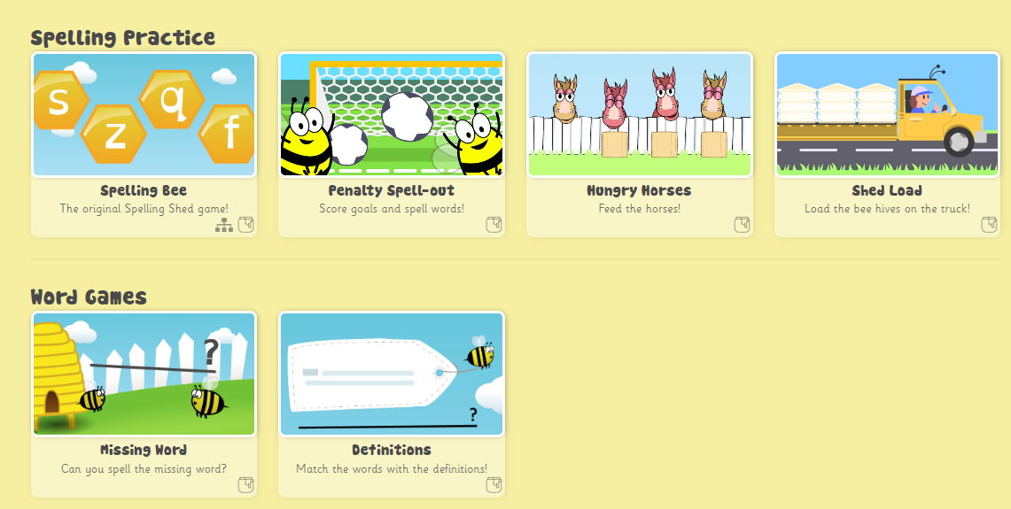
Spelling Shed
Notes:
Your child will be set a new assignment on the Spelling Shed website each week. Your child’s login is in their reading record. The website contains games to help your child consolidate their spellings for the week. The more practice the better! Children gain rewards on the game the longer they play and the teacher can monitor this. Stickers will be awarded weekly for accessing this.

Slide 18

TT Rockstars
Notes:
Times tables rock stars is a game that enables children to practice their speed and recall of times tables facts – the teacher will set your child a times table to practice and monitor their progress. This should also be completed every week. The longer spent on there, the more coins accumulated!

Slide 19
Communication
All communication should go through the school office, preferably by Email for all non-urgent issues.
Staff will acknowledge the email within 2 days, and a full response will follow as per the home-school communication policy.
We may contact you through emails and messages on MCAS (My Child At School) Please ensure your push notifications are allowed to receive your notifications.

