Slide 1

St Michaels and All Angels Curriculum Evening 2026
ST MICHAEL & ALL ANGELS C. E. (FOUNDATION) PRIMARY
AND PRE-SCHOOL
Welcome to Year 6!
Mrs Piper

Slide 2
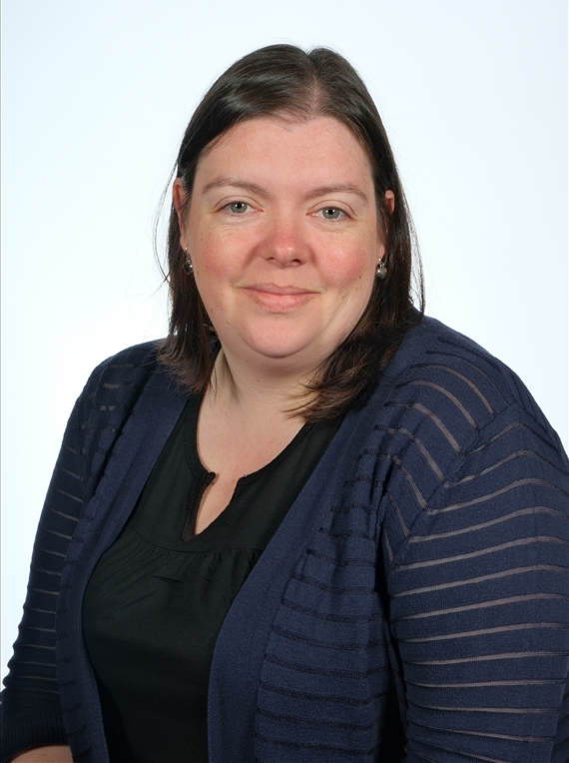
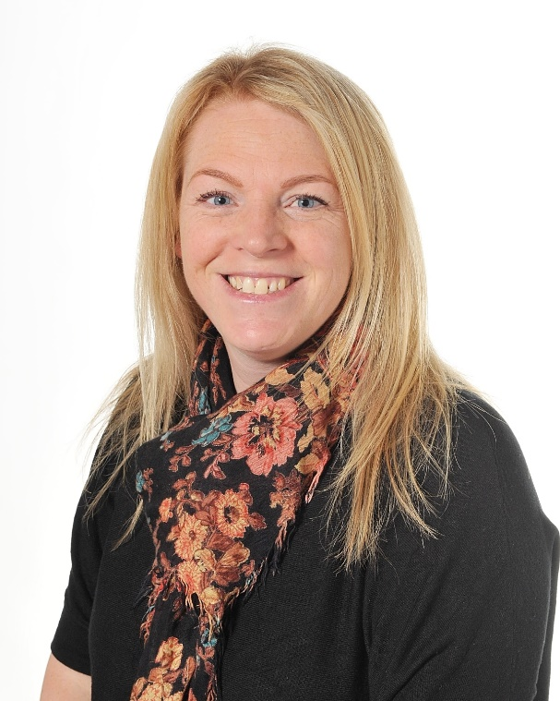
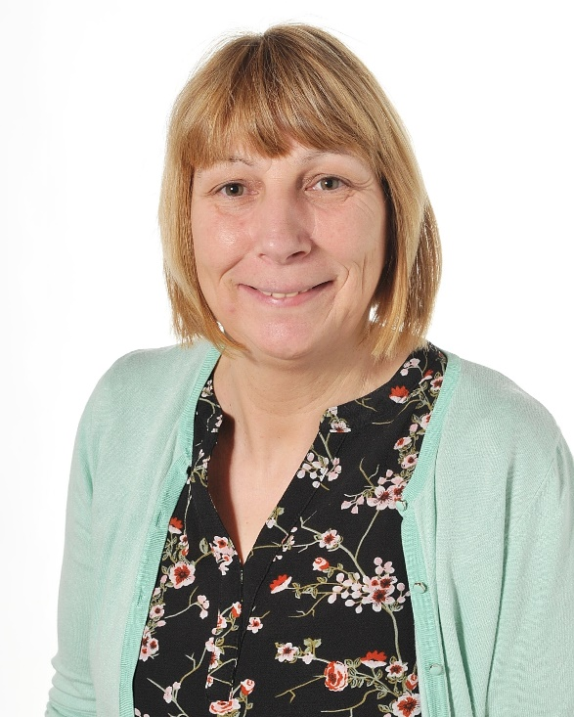
Our Staff
These are the staff working in Year 6 this year.
Mrs Nalton
Mrs Piper
Miss Hobson

Slide 3






School Values
School Vision
Curious minds, resilient learners, compassionate community.
Be strong and courageous (Joshua 1:9)

Slide 4
What are the expectations in Year 6 and what do we learn?

Slide 5
Year 6 objectives: Reading
WORD READING
Apply phonic knowledge and skills to read unfamiliar words.
Apply knowledge of root words, prefixes and suffixes to read aloud and to understand the meaning of unfamiliar words.
Read further exception words, noting the unusual correspondences between spelling and sound, and where these occur in the word.
Attempt pronunciation of unfamiliar words drawing on prior knowledge of similar looking words.

Slide 6
COMPREHENSION
Maintain positive attitudes to reading and understanding of what they read
Read and discuss an increasingly wide range of fiction, poetry, plays, non-fiction and reference books or textbooks.
Read books that are structured in different ways.
Read for a range of purposes.
Become familiar with a wide range of books, including modern fiction, fiction from our literary heritage, and books from other cultures and traditions.
Recommend books that they have read to their peers, giving reasons for their choices.
Identify and discuss themes in a range of writing and across longer texts.
Identify and discuss the conventions of different text types.
Make comparisons within and across books.
Learn a range of poetry by heart. For example, narrative verse, sonnet.
Prepare poems and plays to read aloud and to perform, showing understanding through intonation, tone, volume and action.
Understand books read independently
Check that the book is meaningful and discuss what has been understood.
Use meaning-making strategies to explore the meaning of unfamiliar words and figurative and idiomatic language in context.
Ask questions to extend understanding.
Draw inferences such as inferring characters' feelings, thoughts and motives from their actions and develop explanations.
Predict what might happen from details stated and implied from across a text.
Summarise the main ideas drawn from more than one paragraph, identifying key details that support the main ideas.
Identify and explain the effect of the context on a text. For example, historical, geographical.
Identify and explain how language, structure and presentation contribute to the meaning of a text.

Slide 7
Discuss and evaluate how authors use language, including figurative language, considering the impact on the reader.
Identify and comment on writer’s choice of language.
Identify and explain how writers use grammatical features for effect . For example, the use of short sentences to build tension.
Show awareness of the writers’ craft by commenting on use of language, grammatical features and structure of texts.
Participate in discussions about books that are read to them and those they can read for themselves, building on their own and others’ ideas and challenging views courteously.
Express a personal point of view about a text, giving reasons linked to evidence from texts..
Raise queries about texts.
Make connections between other similar texts, prior knowledge and experience and explain the links.
Compare different versions of texts and explain the differences and similarities.
Listen to others’ ideas and opinions about a text.
Build on others’ ideas and opinions about a text in discussion.
Explain and discuss their understanding of what they have read, including through formal presentations and debates, maintaining a focus on the topic and using notes where necessary.
Explain the main purpose of a text and summarise it.
Present and explain the author’s viewpoint in a text.
Present a personal point of view based on what has been read.
Present a counter-argument in response to others’ points of view.
Provide reasoned justifications for their views.
Explain a personal point of view, giving reasons and evidence from text.
Distinguish between statements of fact and opinion.
Retrieve, record and present information from non-fiction. collate
Find relevant information and evidence from a range of texts.
Record, collate and organise information or evidence appropriately.

Slide 8
Year 6 Objectives: Writing
TRANSCRIPTION
Know how to:
Convert verbs into nouns by adding suffixes. For example, tion, ure.
Distinguish between homophones and other words which are often confused.
Spell identified commonly misspelt words from Year 5 and 6 word list.
Understand that the spelling of some words needs to be learnt specifically.
Use dictionaries to check the spelling and meaning of words
Use the first three or four letters of a word to check spelling, meaning or both of these in a dictionary
Use a thesaurus.
Use a range of spelling strategies.
Handwriting
Write legibly fluently and with increasing speed
Choose which shape of a letter to use when given choices and deciding, as part of their personal style, whether or not to join specific letters.
Choose the writing implement that is best suited for a task (e.g. quick notes, letters).

Slide 9
COMPOSITION
Plan writing.
Identify the audience for and purpose of the writing.
Select the appropriate form and register for the audience and purpose of the writing.
Note and develop initial ideas.
Use knowledge of the writer’s craft from their reading.
Use knowledge from research.
Draft and write
Use the appropriate grammar and vocabulary for the audience and purpose.
Understand how grammar and vocabulary choices can change and enhance meaning to impact on the reader.
In narratives, integrate description of settings, characters and atmosphere and dialogue to convey character and advance the action.
Précis longer passages, conveying key information.
Use a wide range of devices to build cohesion within and across paragraphs.
Use organisational and presentational devices to structure text and to guide the reader. For example - headings, bullet points, underlining
Evaluate and edit
Assess the effectiveness of their own and others’ writing.
Suggest changes to vocabulary, grammar and punctuation to enhance effects and clarify meaning.
Ensure the consistent and correct use of tense throughout a piece of writing.
Ensure correct subject and verb agreement when using singular and plural.
Distinguish between the language of speech and writing.
Distinguish between the correct subject and verb agreement when using singular and plural.
Distinguish between the language of speech and writing and choose the appropriate register.
Proof-read for spelling and punctuation errors.
Perform their own compositions, using appropriate intonation, volume, and movement so that meaning is clear.

Slide 10
VOCABULARY, PUNCTUATION AND GRAMMAR
Develop understanding of grammatical features
Recognise the difference between vocabulary and structures that are appropriate for formal and informal speech and writing, including subjunctive
Use the subjunctive where appropriate in formal writing and speech. For example - If I were to insist, It is essential that he be available.
Use passive verbs to affect the presentation of information in a sentence.
Use expanded noun phrases to convey complicated information concisely.
Indicate grammatical features with punctuation
Use hyphens to avoid ambiguity.
Use semi-colons, colons or dashes to mark boundaries between main clauses.
Use a colon to introduce a list.
Punctuate bullet points consistently.
Use the terminology:
Active and passive, subject and object, hyphen, antonym, synonym, colon, semi-colon, bullet points, ellipsis
Understand the terminology.
Use the terminology to talk about own writing.

Slide 11
Spelling non - negotiables | Example Words
Adding suffixes beginning with vowel letters to words ending in –fer | referring, referred, referral, preferring, preferred, transferring, transferred, reference, referee, preference, transference
Words ending in –ant, –ance/–ancy, –ent, –ence/–ency | observant, observance, (observation), expectant (expectation), hesitant, hesitancy (hesitation), tolerant, tolerance (toleration) substance (substantial) innocent, innocence, decent, decency frequent, frequency confident, confidence (confidential) assistant, assistance, obedient, obedience, independent, independence
Endings which sound like /ʃəs/ spelt –cious or –tious | vicious, precious, conscious, delicious, malicious, suspicious ambitious, cautious, fictitious, infectious, nutritious
Endings which sound like /ʃəl/ | official, special, artificial, partial, confidential, essential
Homophones and other words that are often confused | advice/advise, device/devise, licence/license,practice/practise, prophecy/prophesy,farther/further/father principal: adjective – most important (e.g. principal ballerina) noun – important person (e.g. principal of a college)/principle: basic truth or belief profit: money that is made in selling things/prophet: someone who foretells the future stationary: not moving/stationery: paper, envelopes wary: cautious/weary: tired.

Slide 12
Maths
‘Must Dos’ by the end of Year 6
Number
Read, write and order numbers to 10,000,000
Round any number to any degree of accuracy
Add and subtract negative numbers
Multiply a 4-digit number by a 2-digit number
Divide a 4-digit number by a 2-digit number, expressing remainder as a fraction, decimal fraction or by rounding to whole numbers
Mental Agility: Calculations involving large numbers
Mental Agility: Calculations involving two operations
Use estimation to check answers
Carry out problem solving calculations involving all 4 operations
Add and subtract mixed numbers with fractions of different denominations
Number
Fractions: Multiply simple fractions, writing answers in their simplest forms
Divide proper fractions by whole numbers
Identify value of each digit in a 3 decimal place number
Multiply decimal fraction with 3 decimal places by 10, 100 and 1000
Multiply and divide a number with 2 decimal places by 1-digit and 2-digit numbers
Percentages: Use percentages for comparisons
Calculate percentage of whole numbers
Recall and use equivalences between fractions, decimal fractions and percentages
Ratio: Use ratio to show relative sizes of 2 quantities
Algebra: Solve linear missing numbers
Continue a linear number sequence involving positive and negative numbers

Slide 13
Shape and Measures
Compare and classify geometrical shapes based on properties and size
Find unknown angles in a triangle, quadrilateral and regular polygon
Illustrate and name parts of a circle, including radius, diameter and circumference
Recognise, describe and build 3D shapes
Create a cuboid from a net
Describe properties of 3D shapes and identify parallel planes and symmetry
Estimate size of angles
Describe position on the full coordinate grid
Draw, translate and reflect shapes
Read, write and convert between standard units
Shape and Measures
Calculate area of parallelograms and triangles
Data: Draw, read and interpret graphs
Use and interpret mean as an average

Slide 14





Topics
Sewing – phone case
Vikings
Crime and punishment through history
Comparing countries in Europe with Yorkshire
Cooking & Nutrition - soup

Slide 15
 | AUTUMN ONE | AUTUMN TWO | SPRING ONE | SPRING TWO | SUMMER ONE | SUMMER TWO
Writing | The Nowhere Emporium The Tale of The Three Brothers | Clockwork | Macbeth Topical focus | A Series of Unfortunate Events Chaperon Rouge | Survivors Holes | Holes cont. Climate change (Geography link)
Reading | Retrieval Rex | Inference Iggy Vocabulary Victor | Prediction Pip Summarising Sheba | Cassie the Commentator Arlo the Author | Consolidation of skills | Consolidation of skills
Maths | Place Value Addition, Subtraction, Multiplication and Division | Fractions Converting Units Ratio | Algebra Decimals Fractions, Decimals and Percentages | Area, Perimeter and Volume Statistics Position and Direction | Shape Consolidation | Problem Solving Investigations
Science | Light | Living things and their Habitats | Evolution and Inheritance | Animals including humans |  | Electricity
Geography/ History | Comparing Yorkshire to Eastern European countries? | Vikings | Diversity in USA | Early Islamic Civilisation in Baghdad | Changes to the UK coastline | Crime and punishment through History
Computing | Internet communication | Webpage creation | Variables in games | Introduction to spreadsheets | 3D modelling | Sensing
Religion & World Views | Why do some people go on pilgrimage? | Was Jesus the Messiah? | Creation and science: conflicting or complementary? | What do Christians believe about the old and new covenants? | How and why are Jewish festivals celebrated today? | What does it mean if God is holy and loving?
Art / DT | Painting - powder paint | Sculpture - Alberto Giacometti | Digital Art - Ansel Adams | Textiles | Cooking & Nutrition | Drawing -Perspective Pulleys and Gears
Music | Hey, Mr Miller | Shadows Composing for protest | Dona nobis pacem | You to me are everything Twinkle variations | Race! Exploring identity through song | Ame sau vala tara bal
French | Review Y3/Y4/Y5 The time Daily routine | Physical description Personality | Personality cont. Clothes and colours | Going shopping for clothes In the city and directions | In the city and directions cont. At a café | Occupations/ professions A letter from France
PE | Netball Hockey | Tag Rugby Dodgeball | Gymnastics Handball | Movement to Music Basketball | Cricket Football | Athletics Rounders
PSHCE | Families and Friendship Safe Relationships Respecting ourselves and others |  | Belongings to a community Media literacy and digital resilience Money and Work |  | Physical Health and Mental Wellbeing Growing and Changing Keeping safe

Slide 16
PSHCE
During the Summer Term we will be looking at ways of keeping ourselves healthy.
This will include looking at sensitive topics such as drugs and how these can affect the body.
We will also talk about consent and what this means.
Furthermore, there will be lessons on puberty and how the body changes as we get older, using the correct scientific terminology.
Further information will be sent prior to RSE lessons.

Slide 17
Assessment
External assessment – Reading, Grammar, Maths
Teacher assessment – Writing
Working towards
Expected standard
Greater depth
SATs – Monday 10th May to Thursday 13th May
Writing deadline – End of June
SATs meeting and Residential meeting - TBC

Slide 18
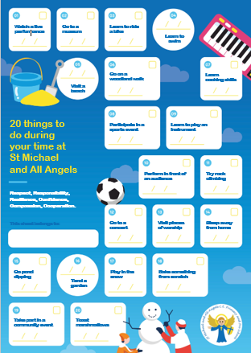
20 Things to Do
During the year, your child will take part in 6 enrichment opportunities.
A local visit
A parent workshop
A school trip
A charity event
An enterprise activity
A visitor

Slide 19
Home Learning
Our home learning has been thoughtfully designed to ensure that it is effective and fun.
The focus is on practising key skills (reading, spelling and times tables).
Teachers closely link homework to children’s current learning to ensure it is accessible and relevant to all.
CPG books will be sent home after half term to be done weekly.

Slide 20

Reading at home
Your child will be sent home with a reading book matched to their reading level. It is important that they are listened to regularly. Reading records should be signed to log this.

Slide 21
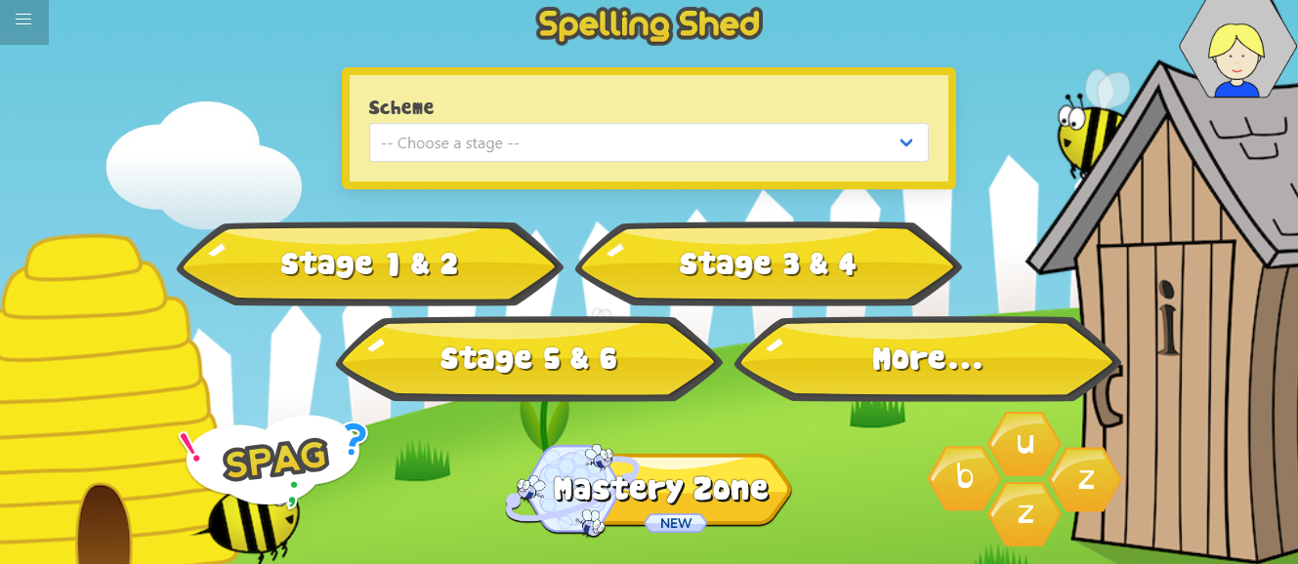

Spelling Shed and TT Rockstars

Slide 22
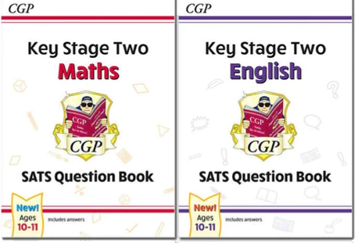
Recommendations
Previous SATS papers
CPG Revision Books
High schools

Slide 23
Communication
All communication should go through the school office, preferably by Email for all non-urgent issues.
Staff will acknowledge the email within 2 days, and a full response will follow as per the home-school communication policy.
We contact you through emails and messages on MCAS (My Child At School) Please ensure your push notifications are allowed to receive your notifications.

